Slide 1
R4R@Q: Get your Head in the Clouds!
How IT Services’ Cloud Technologies can Accelerate your Research Success
Wednesday, November 13, 2019
Stauffer Library, Seminar Room 121
12:30 – 1:30 pm
Stephen Beauregard (IT Services)
Davin Carlson (IT Services)
Brad Hannah (IT Services)

Slide 2
Purpose & Agenda
PURPOSE
To familiarize you with the cloud technologies offered or planned by IT Services that can help you plan, conduct and manage your research
To introduce you to, and seek your feedback on, an important research support initiative: Research Support Services One-Stop Shop
AGENDA
Office365 tools – Davin Carlson
Microsoft Azure and self-serve computing – Brad Hannah
One-Stop Shop for Research Support – Stephen Beauregard

Slide 3
Research Support Services (RSS) Program
A major, cross-institutional initiative, sponsored by the Office of VP (Research), to improve institutional RSS resources, processes and technologies to:
Accelerate researcher success
Advance Queen’s research mission and strategic research plan

Slide 4
Office365 Tools for Researchers
Davin Carlson (IT Services)

Slide 5
Office 365 Overview
Microsoft Office 365 (O365) is a web-based suite of applications, delivered to customers through the cloud.
O365 is Queen's chosen suite of collaboration tools to support the teaching, learning, research and administrative activities of the Queen's community.

Slide 6
O365 Applications
There are many applications currently available within O365
Bookings*
Email & Calendar
Flow
Forms
Live events (extension of MS Teams)
MyAnalytics
Office 365 ProPlus
Office Delve
One Drive for Business
Planner
Sharepoint Online
Skype for Business
Stream
Sway
Teams
To-Do
Whiteboard
Yammer Enterprise
* Upcoming O365 offering

Slide 7
O365 Benefits
There are many benefits to using O365 cloud applications:
Fully integrated email, calendar, file storage, tasks and contacts
Feature-rich web interface
Seamless mobile integration
Integration with other Office applications and collaboration tools
99.9% service uptime, plus enhanced malware and spam protection from Microsoft

Slide 8
How Do I Access These Resources?
You can install apps and web apps through the O365 portal
Log in to MyQueensU on the Queen’s Homepage and review the software listed on the Software Centre tab
Alternatively you can log into office.com with your Queen’s NetID and see a full listing of applications
If you are unsure how to use an application, there are tutorials available for several products on the Queen’s IT Services website https://www.queensu.ca/its/

Slide 9
Personal Cloud Storage - One Drive for Business
One Drive is an integral part of Microsoft Office 365 where you can:
Store, share, and sync your work files across all your devices
Access them from anywhere, at any time, both online and offline.
Benefits of One Drive:
Securely store all your files
Create, upload, and edit files from your desktop, browser, or mobile devices
Collaborate in real time and easily share files with other Queen's users
* Sharing files outside of your organization is possible via password protected link
Sync files across supported devices and access them from anywhere, at any time, both online and offline
Quickly find your files and documents through intelligent search
Access to Office Online (web-based versions of Excel, Word, PowerPoint, OneNote and Outlook)
5 TB of free storage space per user for your work files

Slide 10
Cloud Collaboration – Microsoft Teams
Microsoft Teams is the new chat-based workspace in Office 365. Teams are built on four core promises: chat for today’s teams, a hub for teamwork, customization options and security teams trust.
Benefits of Teams:
Integration of all O365 tools in a single place
Securely store all your files viewable only by your team members
No additional cost for Office 365 users
Chat feature for communication with team members and others in your organization
Schedule virtual meetings (audio visual) based on your existing O365 calendar
Invite guest members from outside of your organization
External guests will enjoy access to a full O365 instance and all the applications within
10 GB of file storage space per team

Slide 11
Coming Soon - Microsoft Bookings
Microsoft Bookings is an online scheduling app for small offices or departments who provide services to clients on an appointment basis.
Bookings aims to improve the experience of booking appointments, offering:
A 24/7/365 online solution for booking appointments — no calls necessary
Automatic email confirmations and reminders
The ability to cancel or reschedule online
An easy way to add appointments to their calendars
The option to schedule via phone or in person
You can easily add appointments to Bookings manually from a computer or on a mobile device
Student advising
Technology support
Consultation Participant scheduling
Faculty , TA, PA office hours

Slide 12
Microsoft Azure and Self-serve Computing
Brad Hannah (IT Services)

Slide 13
Cloud Computing
What is IT Services up to?
January 2019 began building cloud computing platform
Focus on building a secure cloud environment that facilitates rapid deployment of virtual machines and platform services such as databases
Which Cloud?
IT Services has selected Microsoft Azure as our primary cloud computing platform
Azure provides a comprehensive cloud capable of a considerable number of services including virtual machine, cloud storage and data science tools

Slide 14
Cloud Computing – What’s Coming
The Plan
Self service virtual machine service expected to be offered Summer of 2020 for researchers
Support internal account billing
Improved security controls and protections will help keep your data safe
All systems and data would be directly linked to your Queen’s NetID with no additional user accounts required
Support for simple virtual machines running Windows Server or Linux
Systems vary in size from as little as 20% of a CPU with 512MB RAM to 64 CPUs and 256GB RAM
Charged only while the virtual machine is running (except for storage)

Slide 15
We need your feedback!
We think we have an idea of what you want, but would appreciate if you would provide us your opinions and feedback!
For immediate feedback please email hannahb@queensu.ca
In the future we would appreciate the opportunity to send out a survey and engage to make sure we are delivering services that are valuable

Slide 16
One-Stop Shop for Research Support
A Cross-Institutional Initiative to Improve Institutional Research Support Services (RSS)
Stephen Beauregard (IT Services)
Notes:
Sponsored by the Office of VP Research, we assessed the current state of RSS at Queen’s

Slide 17
My Day(s) in the Life of a Queen’s Researcher
I want to:
Find funding opportunities
Find collaborators
Write and submit a proposal
Plan & Propose
Set Up & Manage
Conduct & Report
Publish & Disseminate
I want to:
Publish my research
Share my data
Speak to the media about my research
I want to:
Administer my funds
Find equipment and facilities
Get ethics certification
I want to:
Collect data
Analyze data
Report findings
Notes:
The RSS Program is committed to a researcher-centric approach, meaning everything starts with understanding your needs and challenges.

Slide 18
How was my Experience with RSS?
Plan & Propose
Set Up & Manage
Conduct & Report
Publish & Disseminate
The Good
100+ research support services available
12+ service providers (internal and external)
The Bad
Navigating and accessing the 100+ services involved at least 6 different websites (and countless clicks!)
Low institutional awareness of all RSS available
Different access channels for different services
The Ugly
Locating and accessing RSS was a time-consuming, confusing and frustrating experience
I had less time for my research
I felt discouraged

Slide 19
RSS - Current Challenges
The RSS experience is currently…
Complex
Disorienting
Siloed
Inconsistent
5,000+ researchers enabled by 100+ RSS from more than a dozen institutional providers, as well as external service providers
No simple way for researchers or support personnel to navigate the vast array of support service available
RSS developed, implemented and made available in a relatively independent and unconnected way across service providers; low institutional awareness of RSS availability
Each RSS may depend on a variety of websites, databases, content management solutions and modes of access (self-serve, phone, in person) to deliver value to researchers

Slide 20
RSS One-Stop Shop - Concept Vision
RSS One- Stop Shop Concept
A solution to meet RSS navigation and access needs that is…
Comprehensive
Collaborative
Intuitive
Consistent
A single gateway for Queen’s researchers and support personnel to navigate and access the rich array of RSS available to them
Researchers and support personnel can access RSS online (web, e-mail, chat) or via other modality (phone, F2F, etc.) and receive the same level of support
Researchers and support personnel easily navigate RSS by researcher type, research lifecycle phase, RSS categorization, etc., for just-in-time support
Service providers collaborate and adopt common standards and practices necessary to improve effective and efficient navigation and access of their RSS

Slide 21
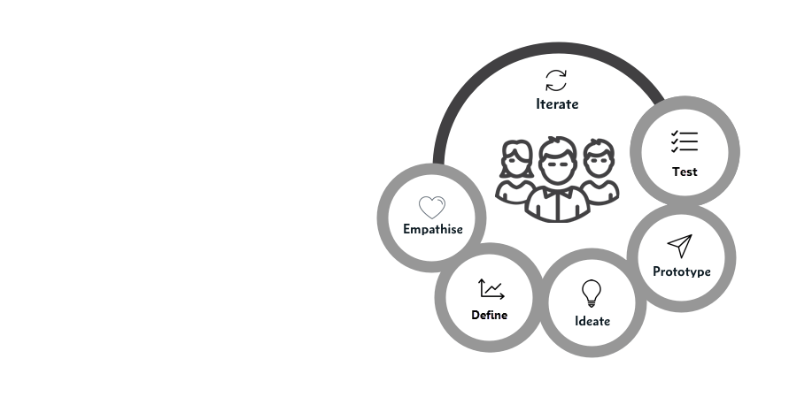
Your Engagement is Key!
We want to engage with researchers to better understand the jobs you want to get done, the pains you experience, and the gains you are seeking
Researchers
Your insight will help to define and prioritize how the one-stop shop can relieve pains and create gains
We will be conducting workshops with researchers in early 2020 to steer the design and provide feedback on early models

Slide 22
Next Steps
Want to participate in our researcher workshops to help steer the design of the one-stop shop?
Leave your contact information with us before you leave today and we will be in touch with further details.
Questions? Feedback?

