Slide 1
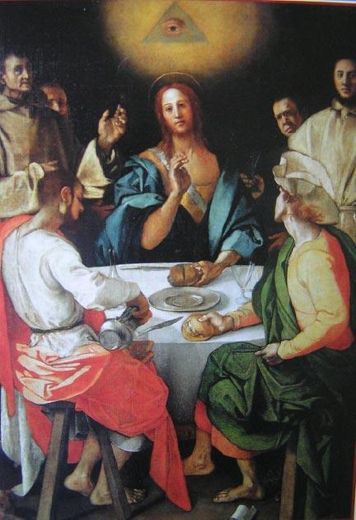
Surveillance and the Eye of God
David Lyon,
Queen’s University

Slide 3
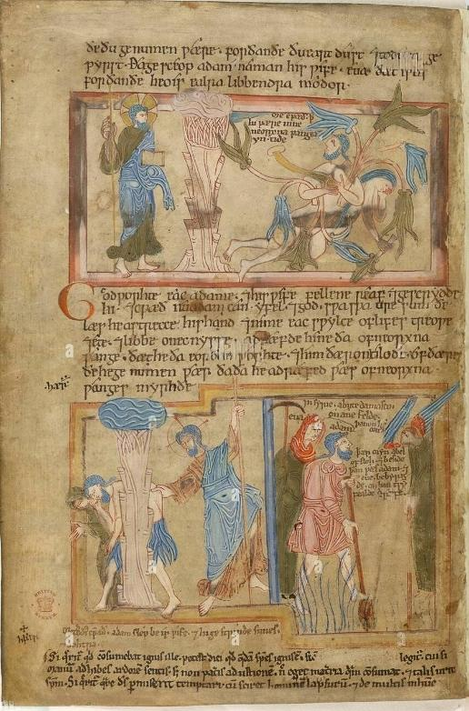

Slide 5
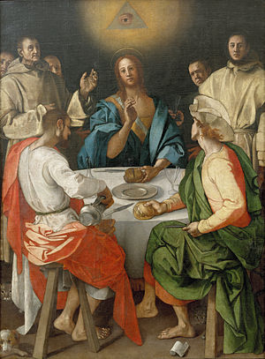
Jacopa da Pontormo
(1494-1557)
“Supper in Emmaus”
(1525)

Slide 6
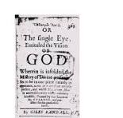
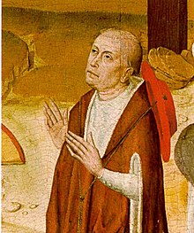
Nicholas of Cusa
(1401-1464)
De Visione Dei
(1453)

Slide 7
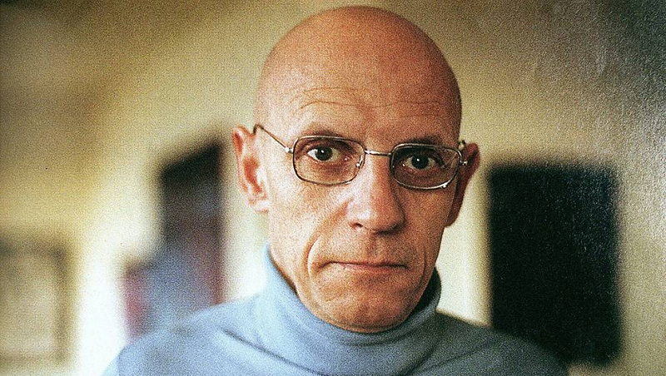
Michel
Foucault
1921-1984

Slide 8
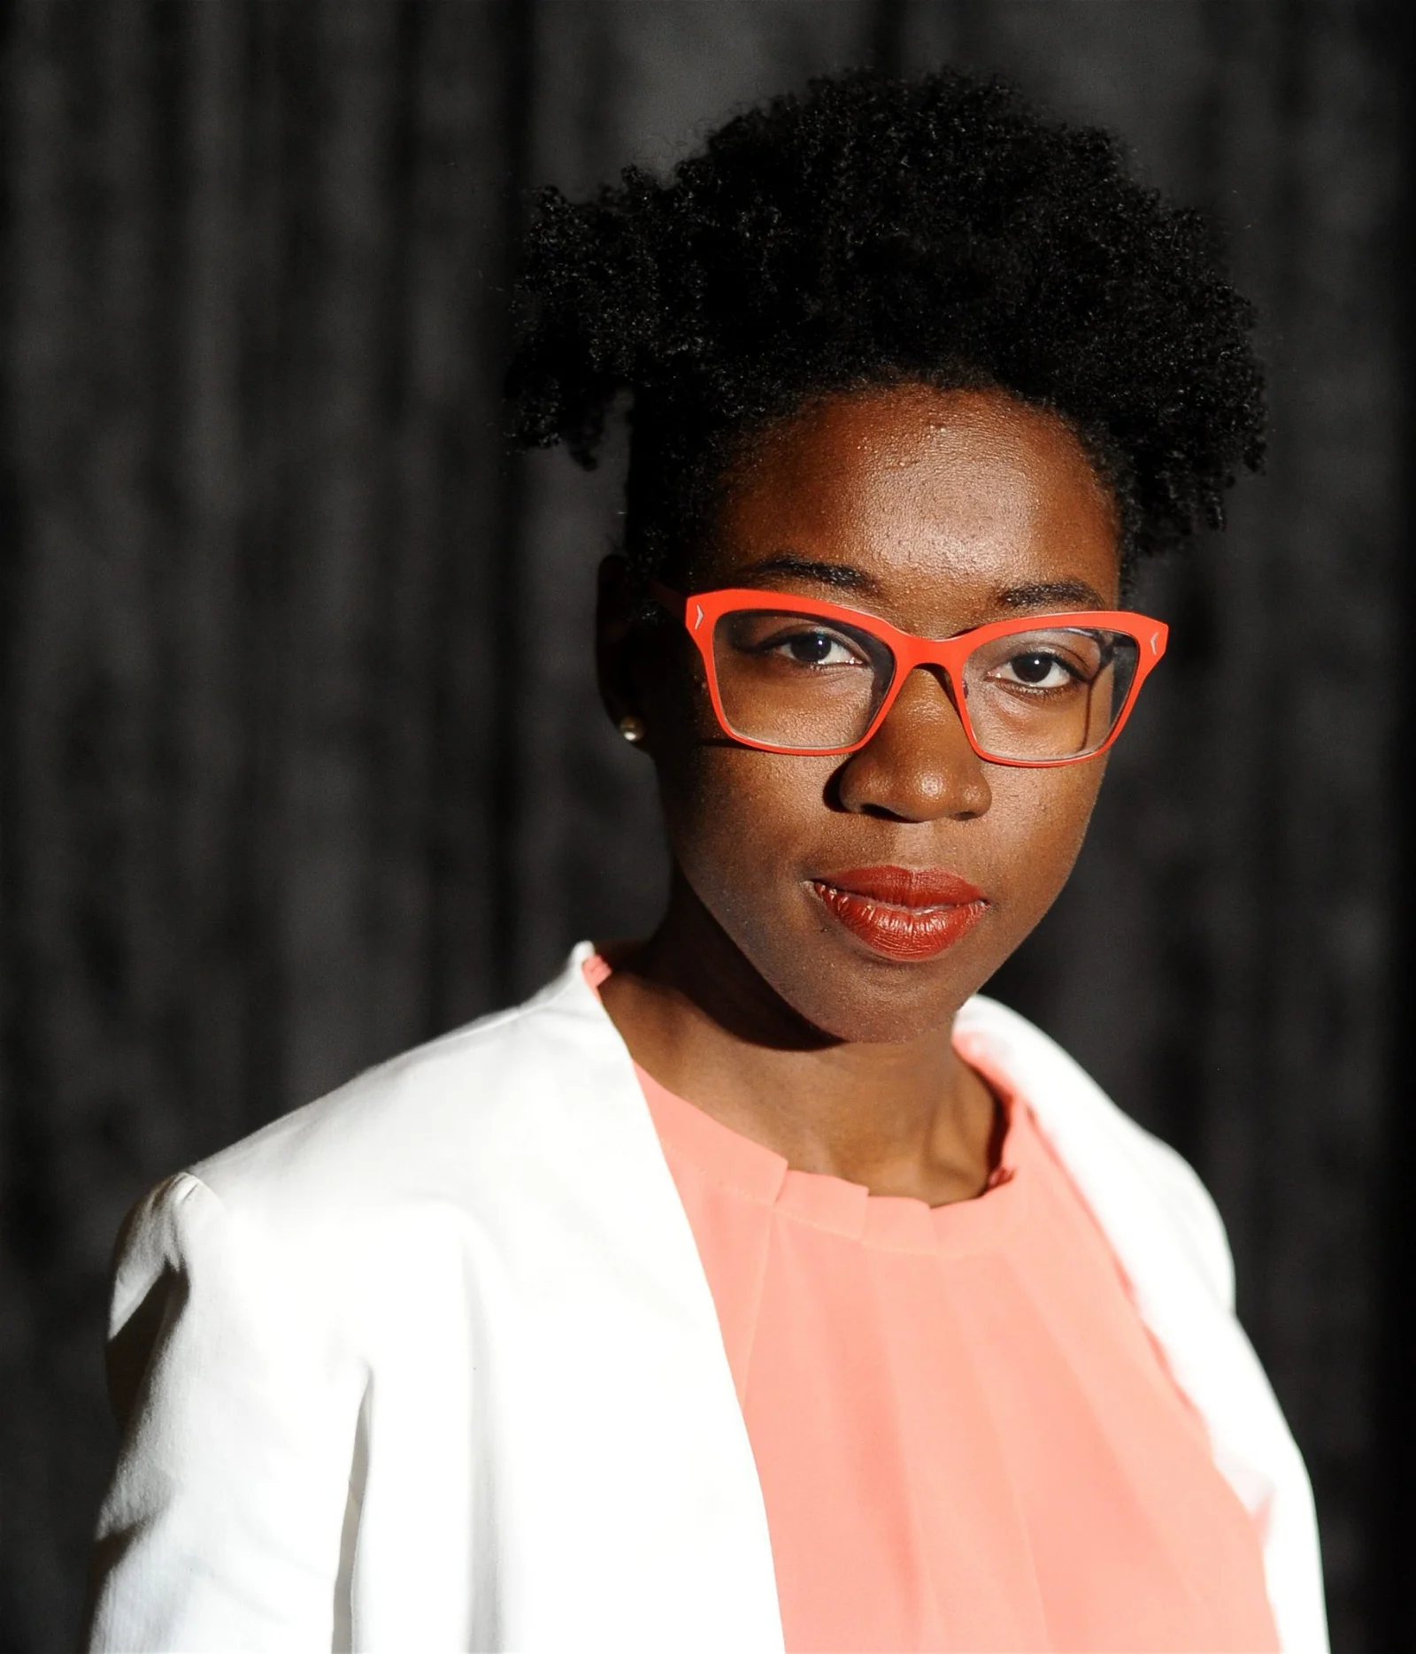
Joy Buolamwini
MIT PhD (2022)

Slide 9
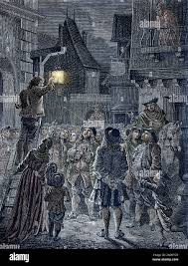
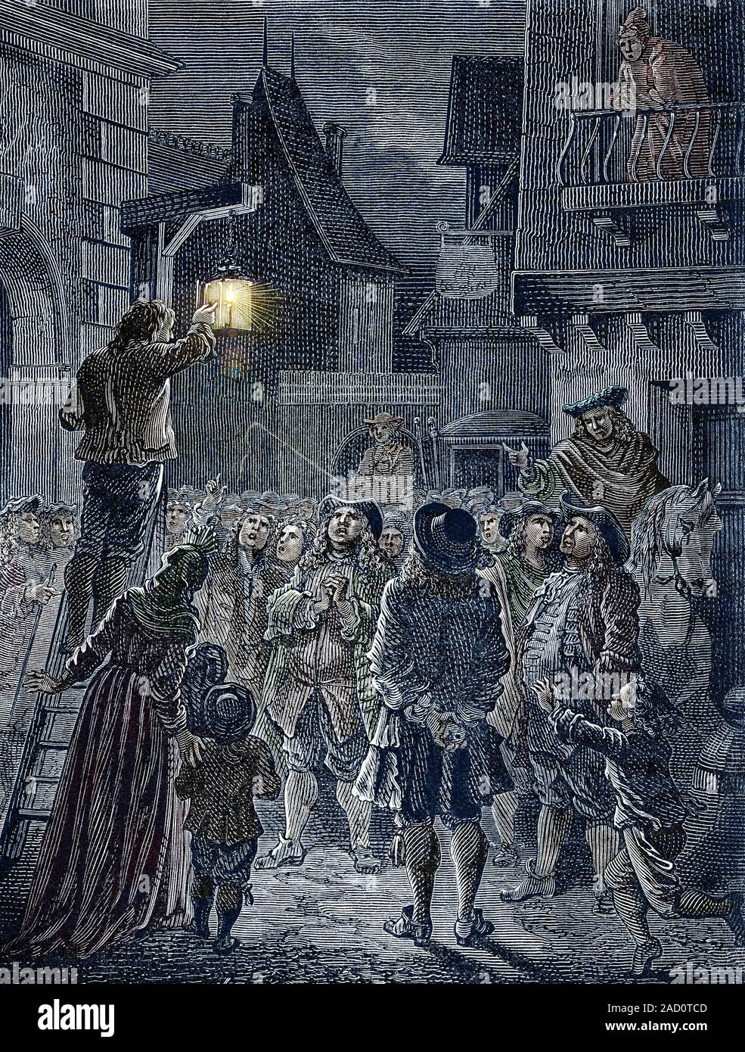
985 × 1,390
Paris: City of Light

Slide 10
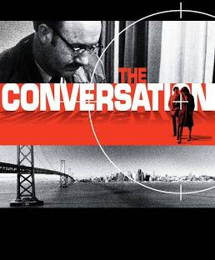

Slide 11
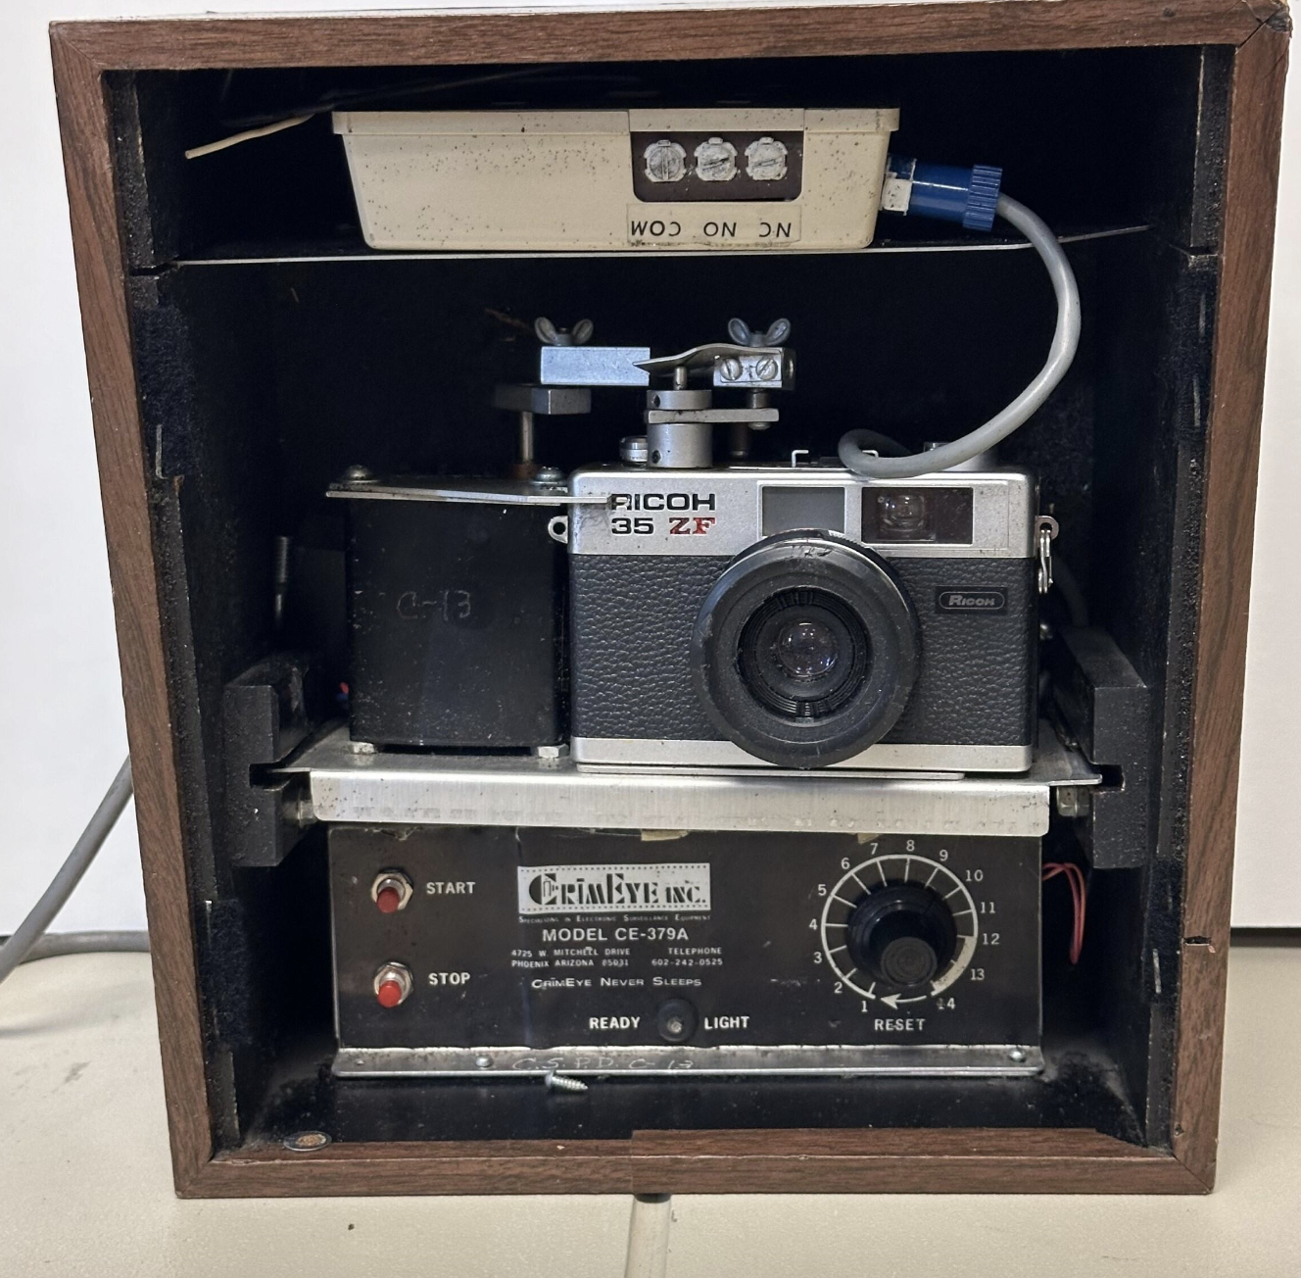

Slide 12
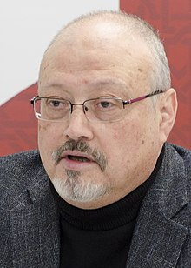
Jamal Khasoggi
(1958-2018)

Slide 13
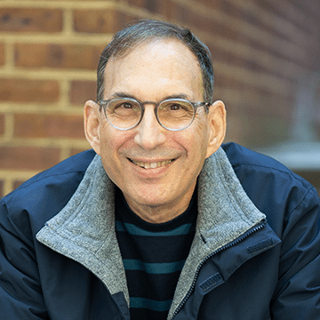
Joseph Turow
University of
Pennsylvania

Slide 14
“Until recently, most of the population of Western Europe understood itself to be under scrutiny by an omniscient and omnipotent Creator, who not only knew the contents of everyone’s correspondence, but also the innermost secrets of their hearts…”
Amanda Power (Oxford U) 2013

Slide 15
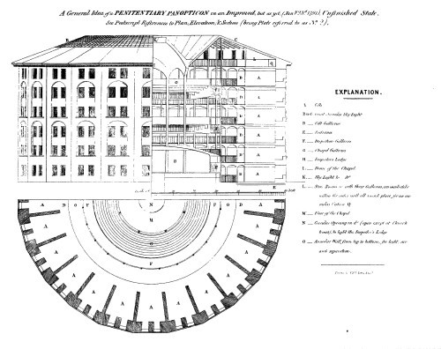

Slide 16
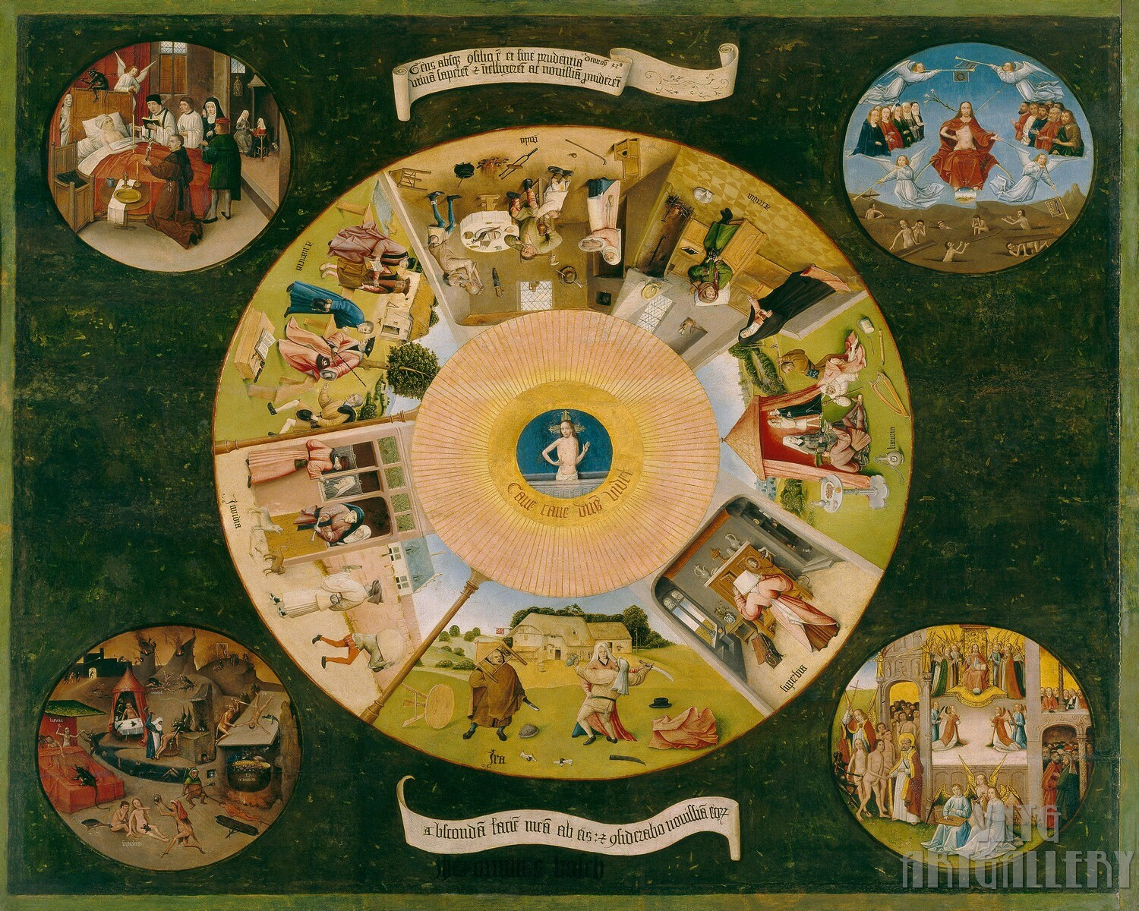

Slide 17
CC

Slide 18
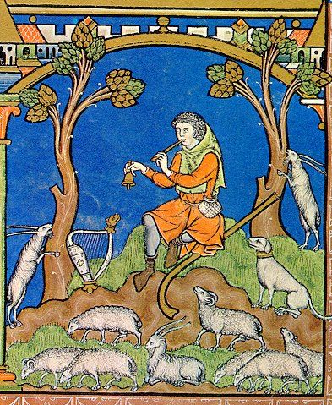

Slide 19
Foucault: “Pastoral power…is fundamentally
beneficent… its essential raison d’être is the
salut (salvation) of the flock… it’s a power of
care.” Security, Territory, Population (1978)
2009.

Slide 20
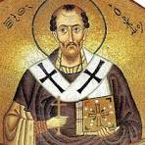
John Chrysostom
d. 407

Slide 21
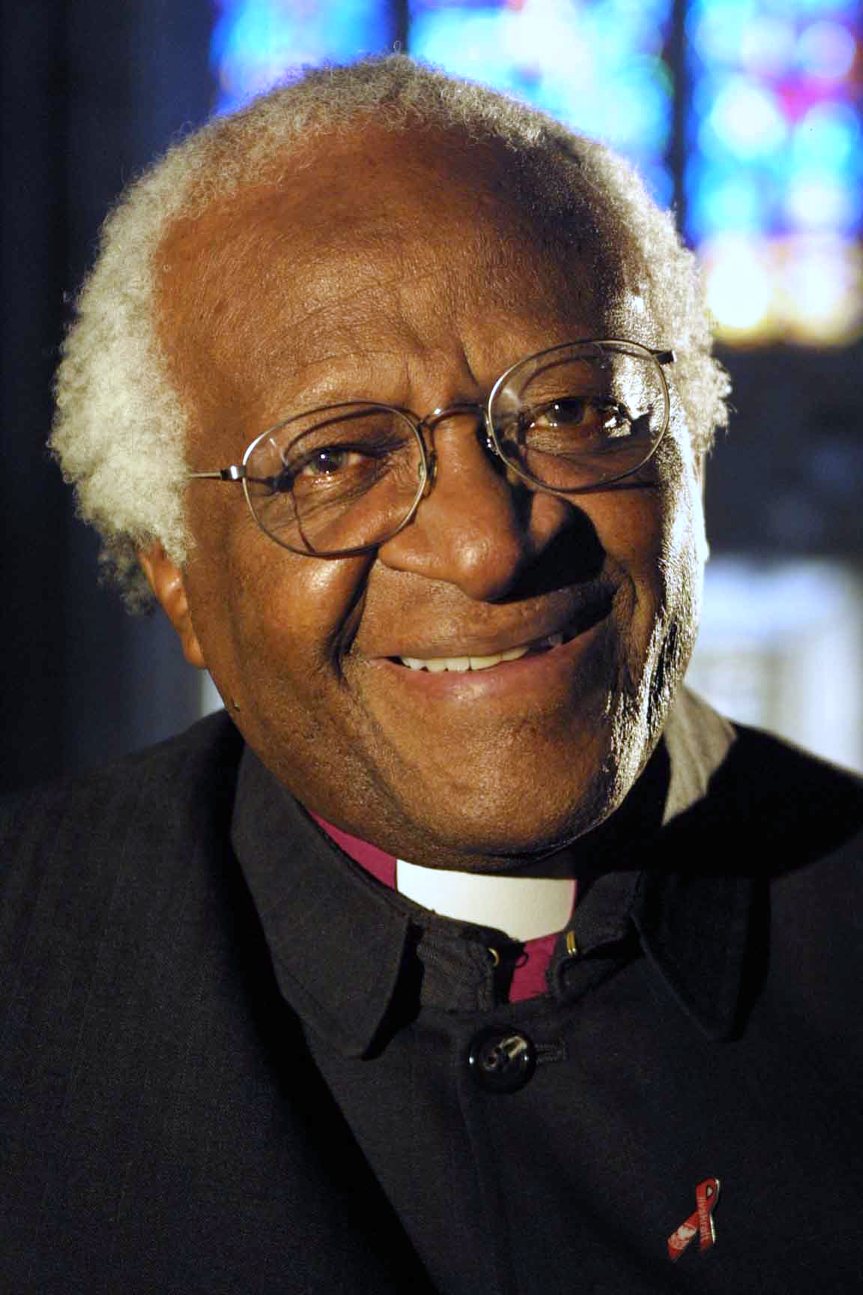
Desmond Tutu (1931-2021)
Desmond

Slide 22
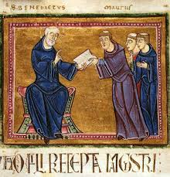
672 × 697
Benedict of
Cassino
(480-547)

Slide 23
Four features of medieval surveillance:
Relationality
Care
Justice
Reliability

Slide 26
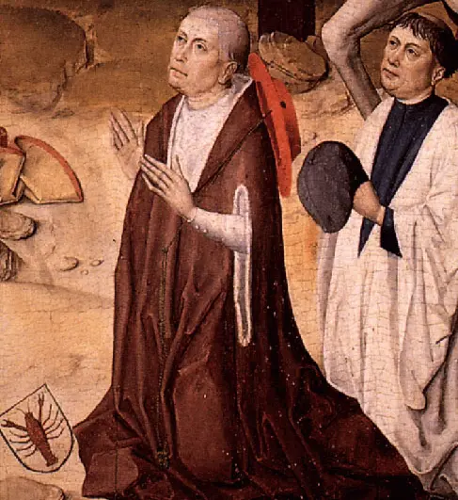

Slide 27
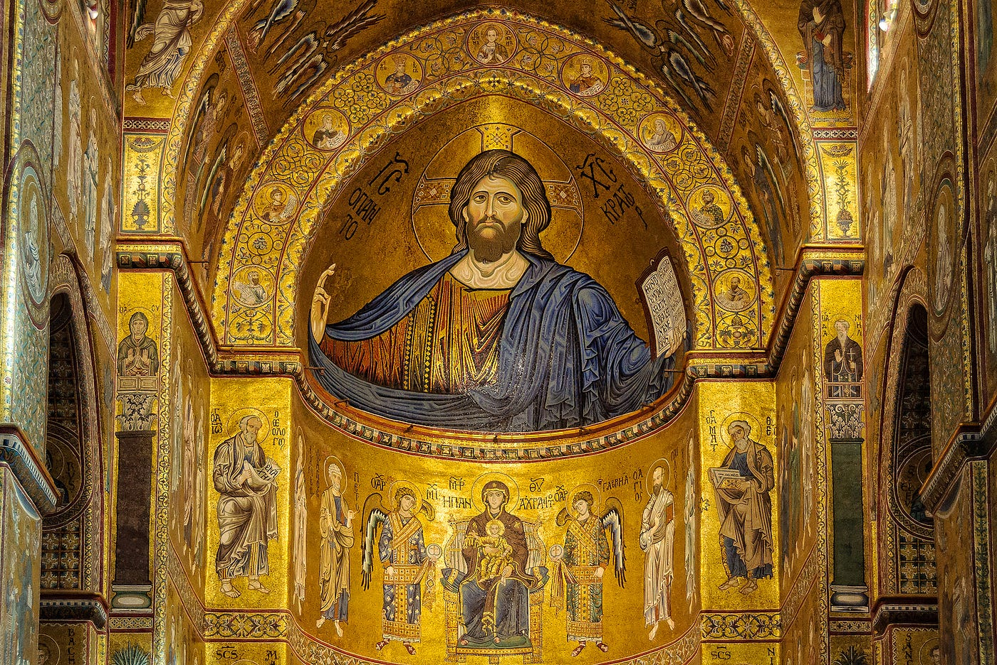

Slide 28
