Slide 1
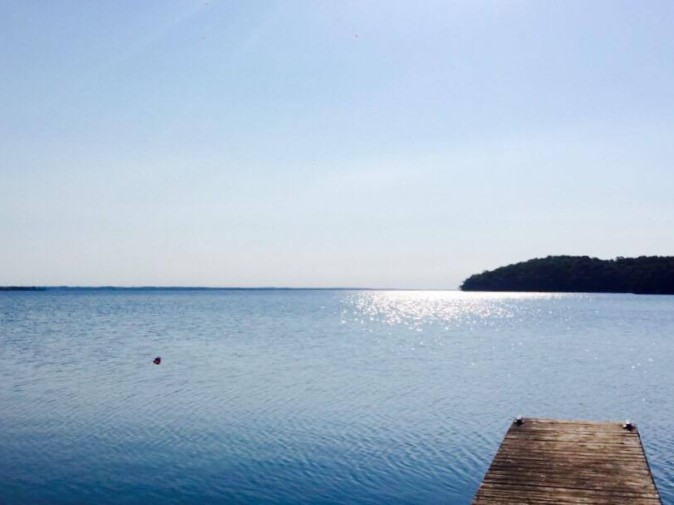


Assessing long-term water quality trends in Ontario Lake Trout lakes using paleolimnology
PALS 2018
Clare Nelligan, Adam Jeziorski, Kathleen M. Rühland, Andrew M. Paterson, and John P. Smol

Slide 2
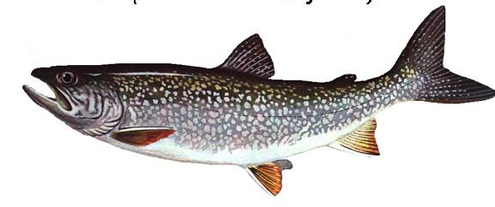
Lake Trout
Lake Trout lakes are relatively rare – only 1% of Ontario lakes
  This represents 20-25% of all Lake Trout lakes worldwide
Good ecological indicator
  Large bodied (30-80 cm in length) and late maturing (5-10 yrs)
  Specific habitat requirements for temperature and oxygen
(OMNRF 2006)
(Photo http://www.hookhack.com/html/fom020113_laketrout.html)

Slide 3
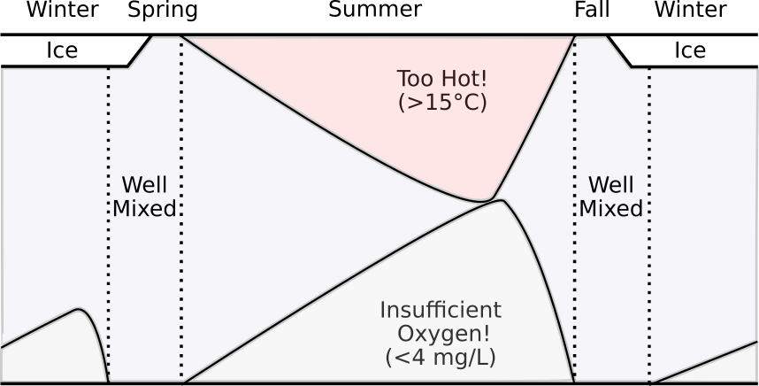
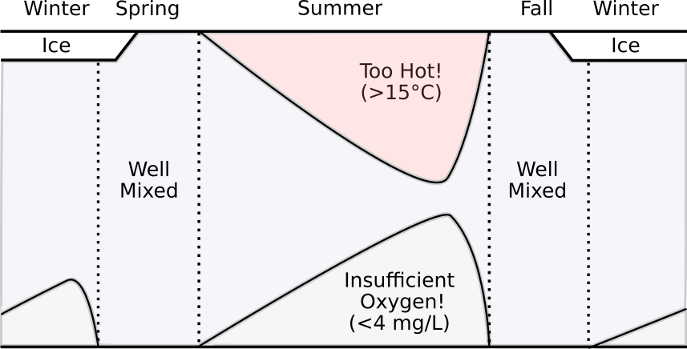

Lake Trout Habitat “Squeeze”
Provincial Standard for Volume-weighted Hypolimnetic O₂ > 7 mg/L
(Evans et al. 2007)
(Figure modified from Guzzo and Blanchfield 2016)

Slide 4
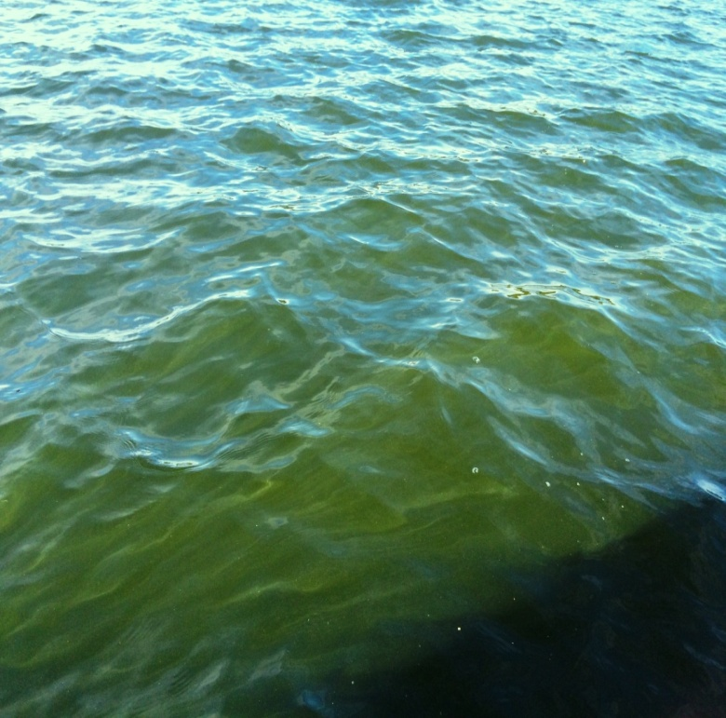
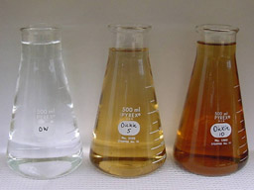
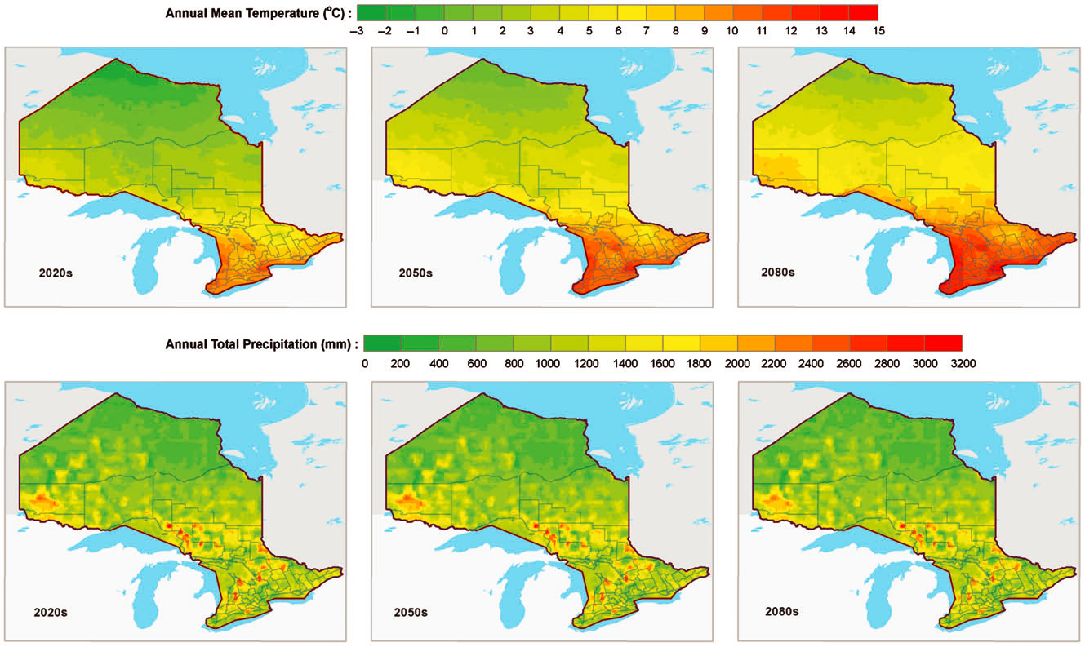
Nutrients (TP)
Dissolved Organic Carbon (DOC)
Climate Warming
(Stratification & Mixing)
(Figure: Wang et al. 2014)
Notes:
Variables that influence hypolimnetic DO

Slide 5
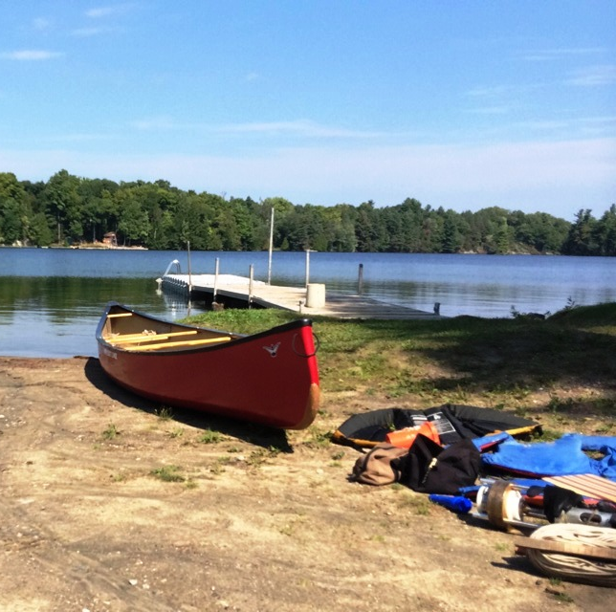
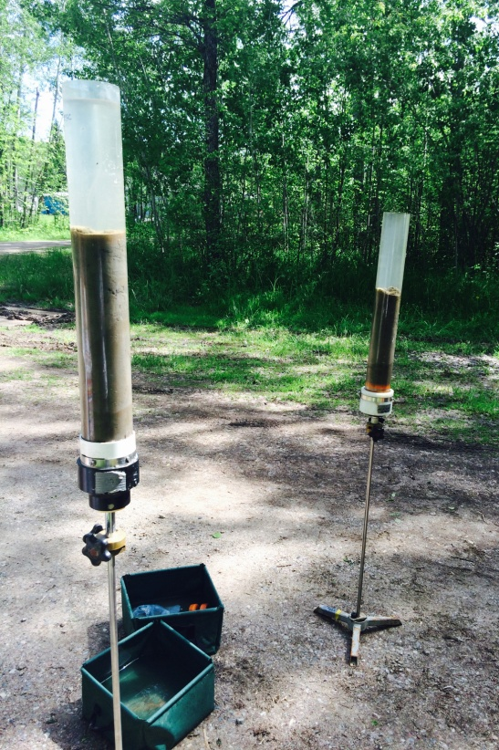
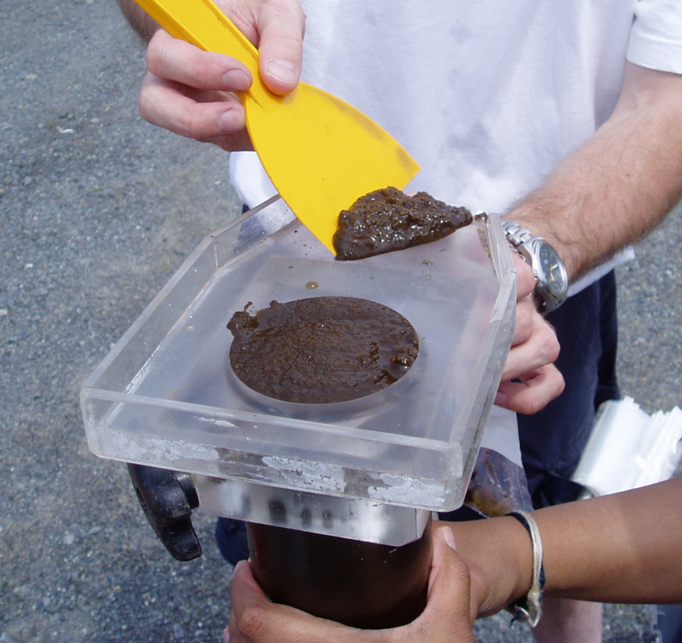
Objectives:
To characterize long-term trends in hypolimnetic oxygen in lakes that support Lake Trout
Identify environmental stressors (e.g., nutrients, warming, DOC, etc.) that may be driving oxygen dynamics in these lakes
Chironomids:
To reconstruct end-of-summer volume-weighted hypolimnetic [O₂] (VWHO)
Diatoms:
To reconstruct [TP] and other environmental drivers (e.g., warming)
Spectral Analyses:
To infer whole-lake primary production (chlorophyll-a) and total organic carbon (TOC)

Slide 6
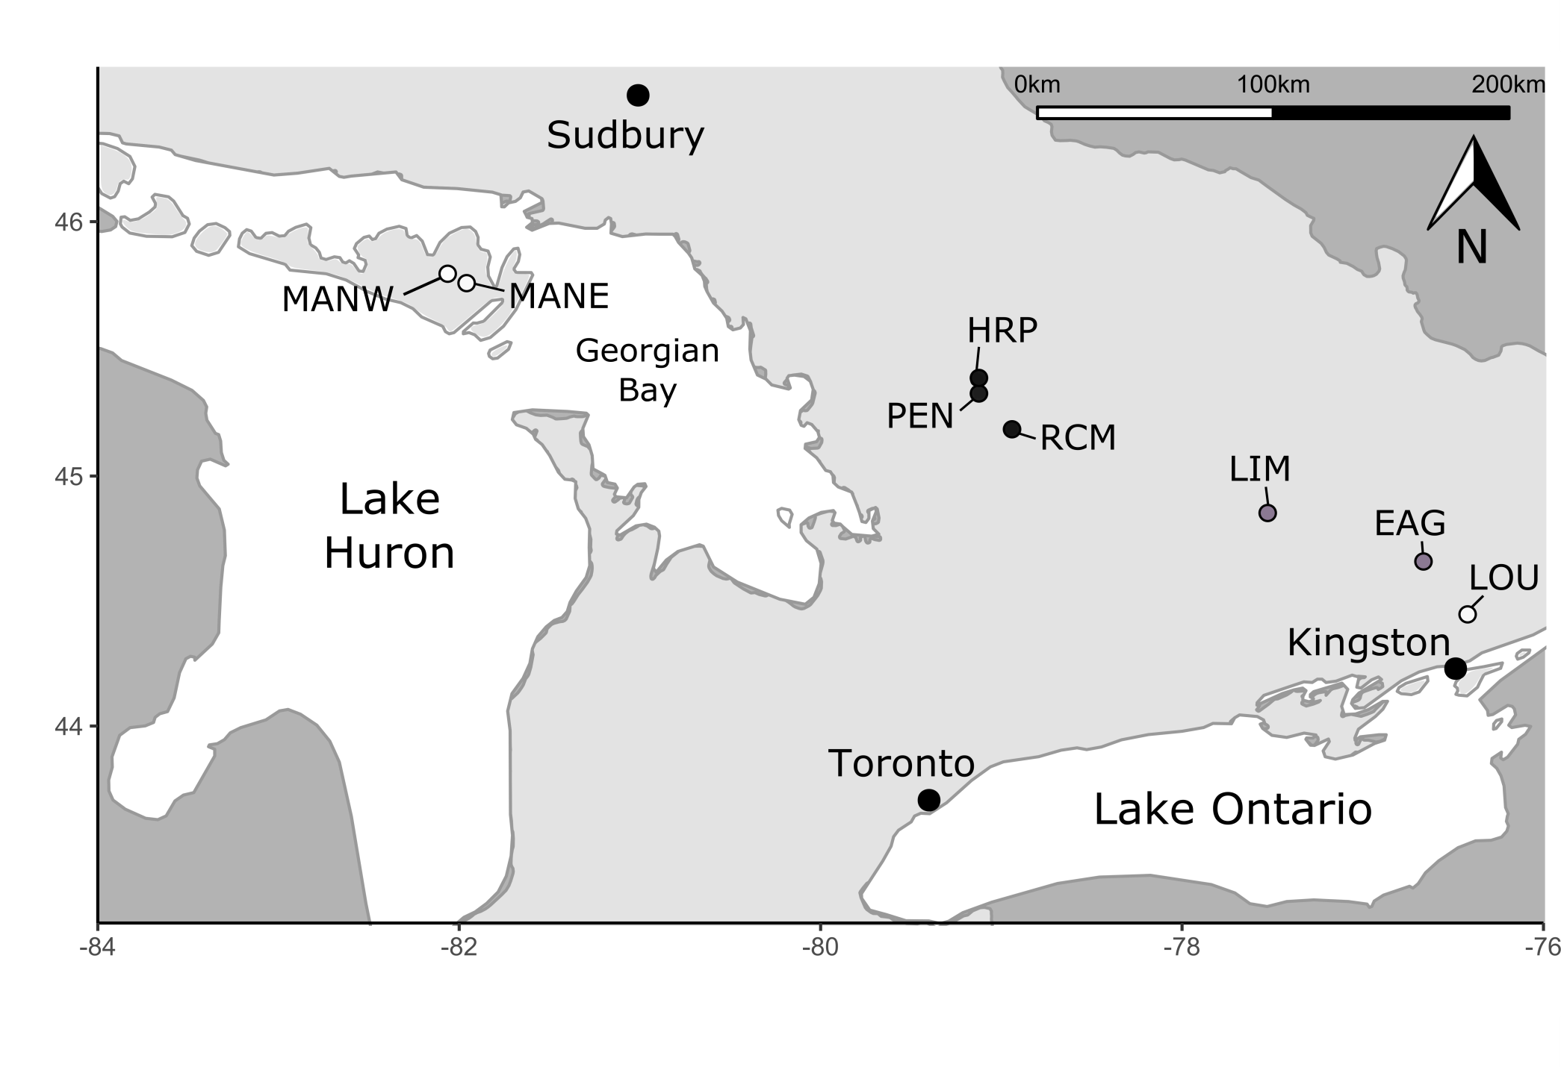
Lakes were selected based on the availability of long-term monitoring data, or because they satisfied one of the following criteria:
Impacted by shoreline development or agriculture
Experienced changes in their [DO] profiles
Identified as below the provincial standard for [DO] in a Lake Trout lake
Of prior management interest

Slide 7
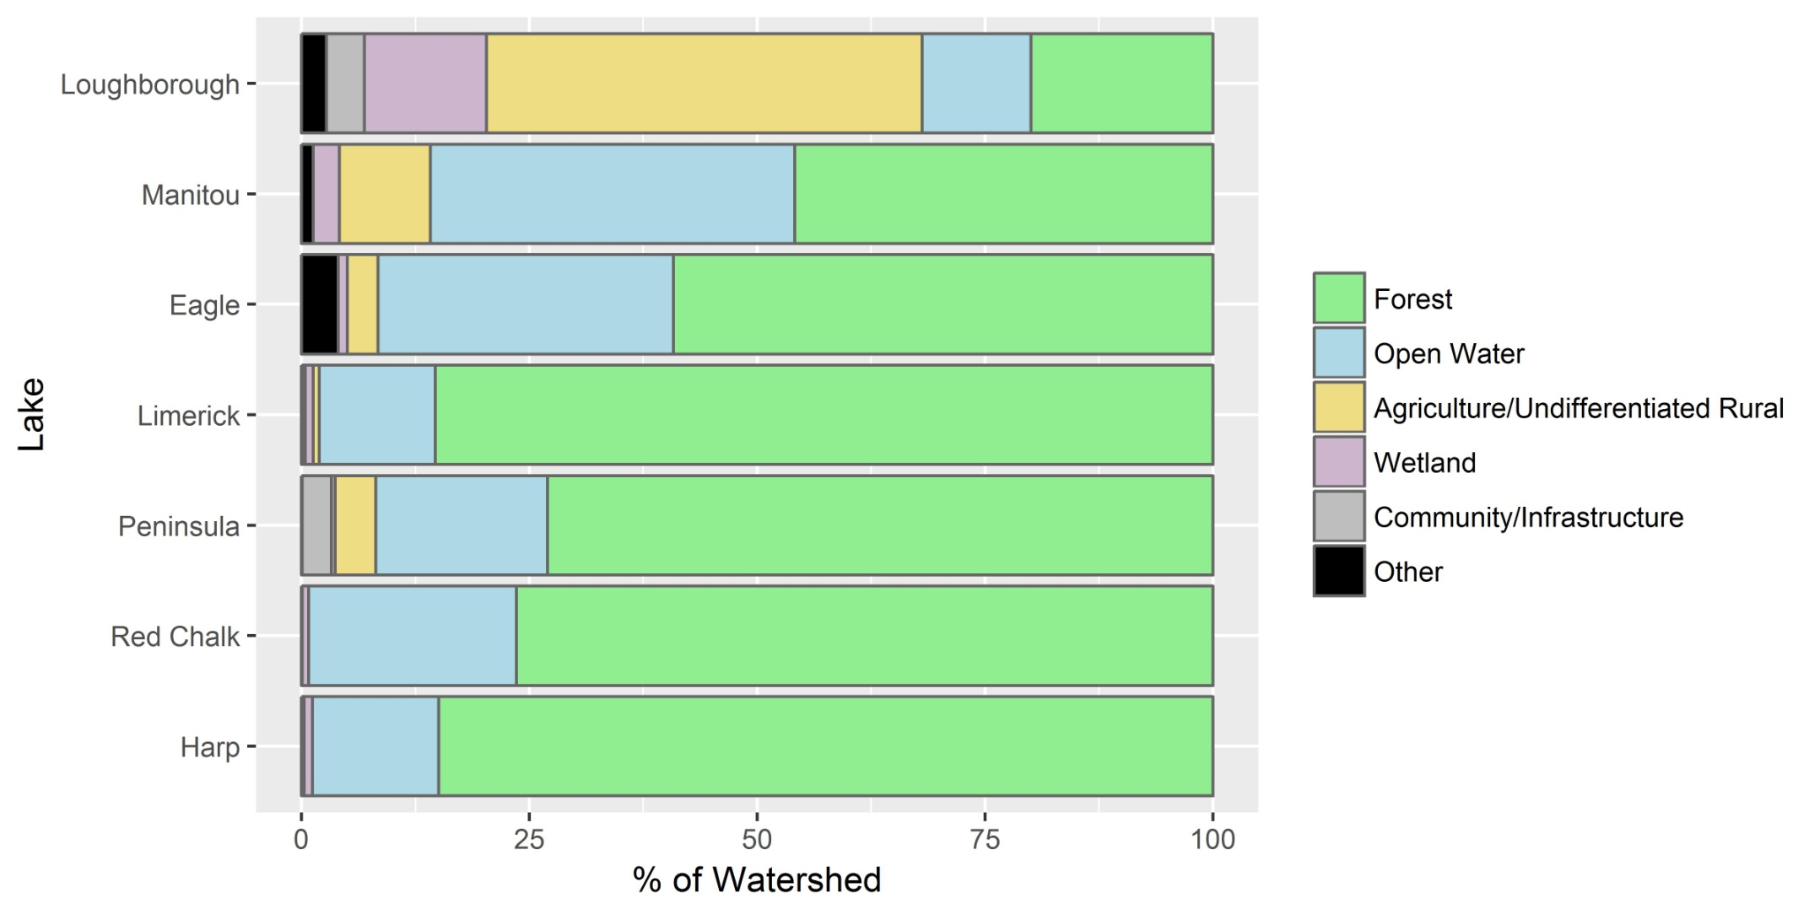
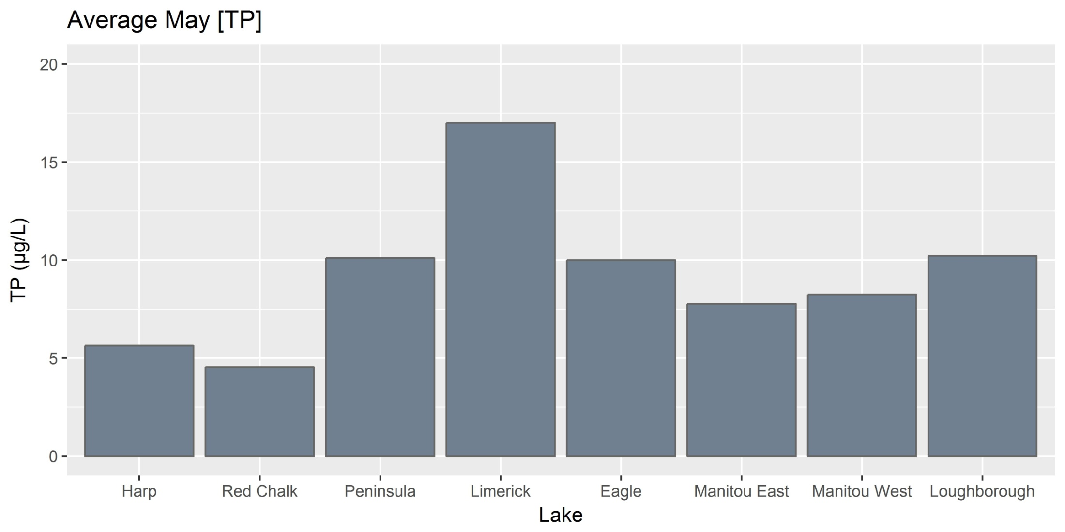
The location of the study lakes on or off the Canadian Shield is important in shaping:
1. The surrounding land-use (agriculture vs. forested)
The type of environmental stressors lakes are exposed to (e.g., acidification, urban development, nutrient loading, etc.)
Water chemistry (e.g., pH and TP)
pH Range: 6.6 – 7.2
Off-Shield
pH Range: 8.0 – 8.4
Transition
*
Shield
Notes:
May TP data average for years with available water chemistry between 2000 and present. Peninsula is July TP. Limerick TP data driven by high TP (20-30 ug/L) during May and July of 2006.
Harp and Red Chalk have lowest TP – other lakes are generally oligotrophic but occasionally cross into the mesotrophic range

Slide 8
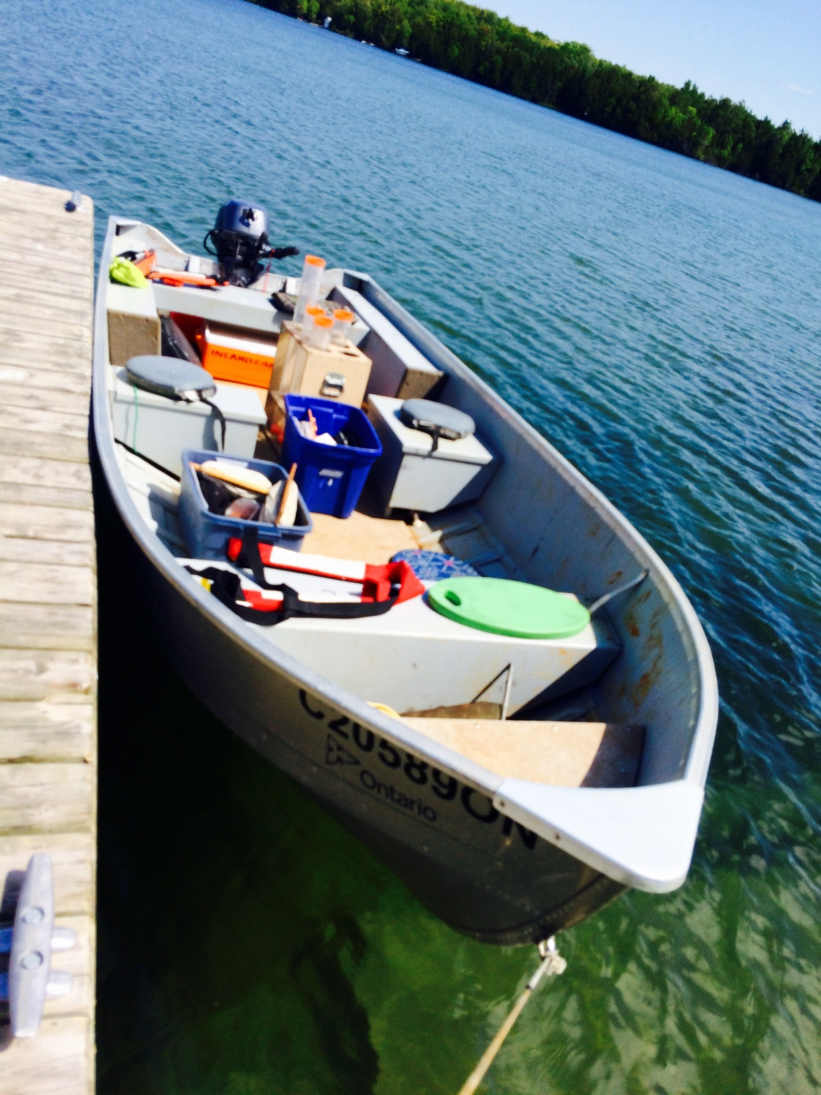
Methods
Gravity cores were collected from the study lakes between 2013 and 2016
Cores were ²¹⁰Pb dated and analyzed for diatoms, chironomids, and spectrally-inferred chl-a and TOC
TP was reconstructed using the Hall and Smol (1996) and Reavie and Smol (2001) diatom transfer functions
Chironomid-inferred VWHO was determined using the Quinlan and Smol (2001, 2010) model
Paleo-reconstructions were standardized to Z scores and analyzed from ~1900-present

Slide 9
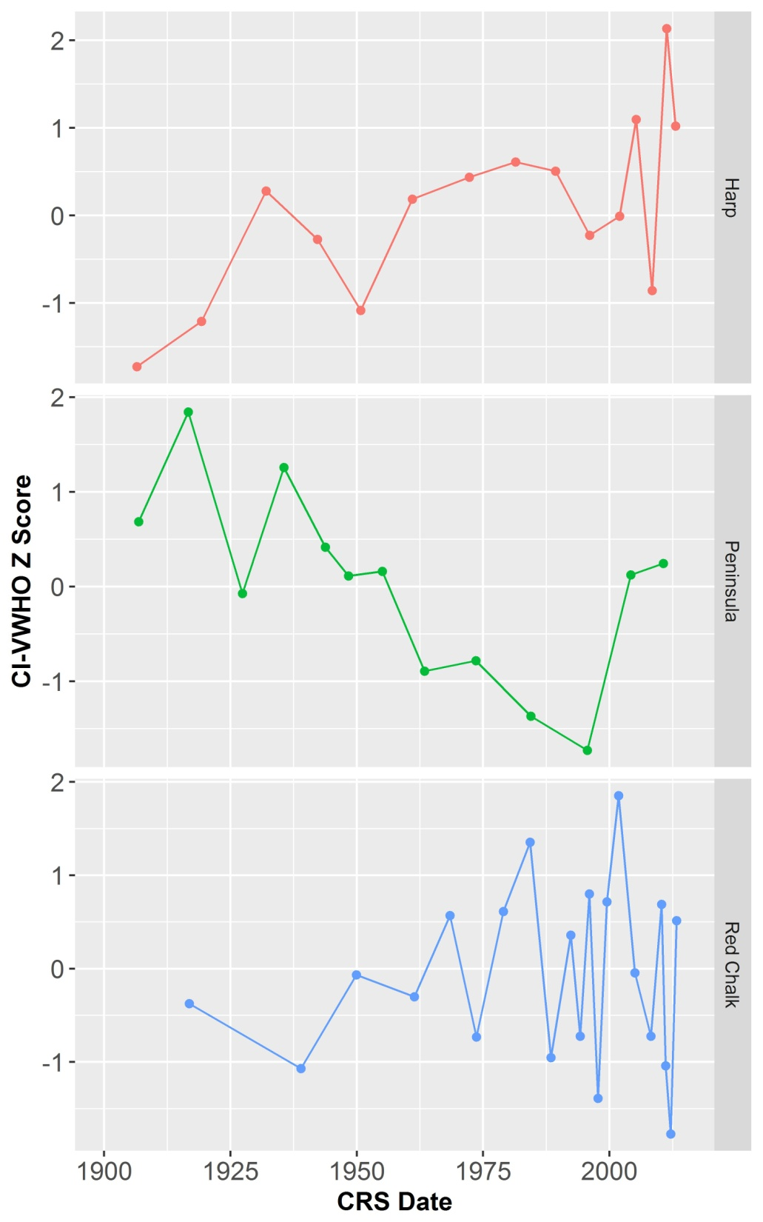
Chironomid-inferred VWHO Data
CI-VWHO trends were lake-specific
Only Harp Lake and Peninsula Lake had significant directional trends in CI-VWHO since ~1900
Interestingly, a few of the study lakes exhibit a slight increase in CI-VWHO in the most recent sediments
Shield Lakes
Τ = 0.52, p = 0.006
*
*
Τ = -0.436, p = 0.04

Slide 10
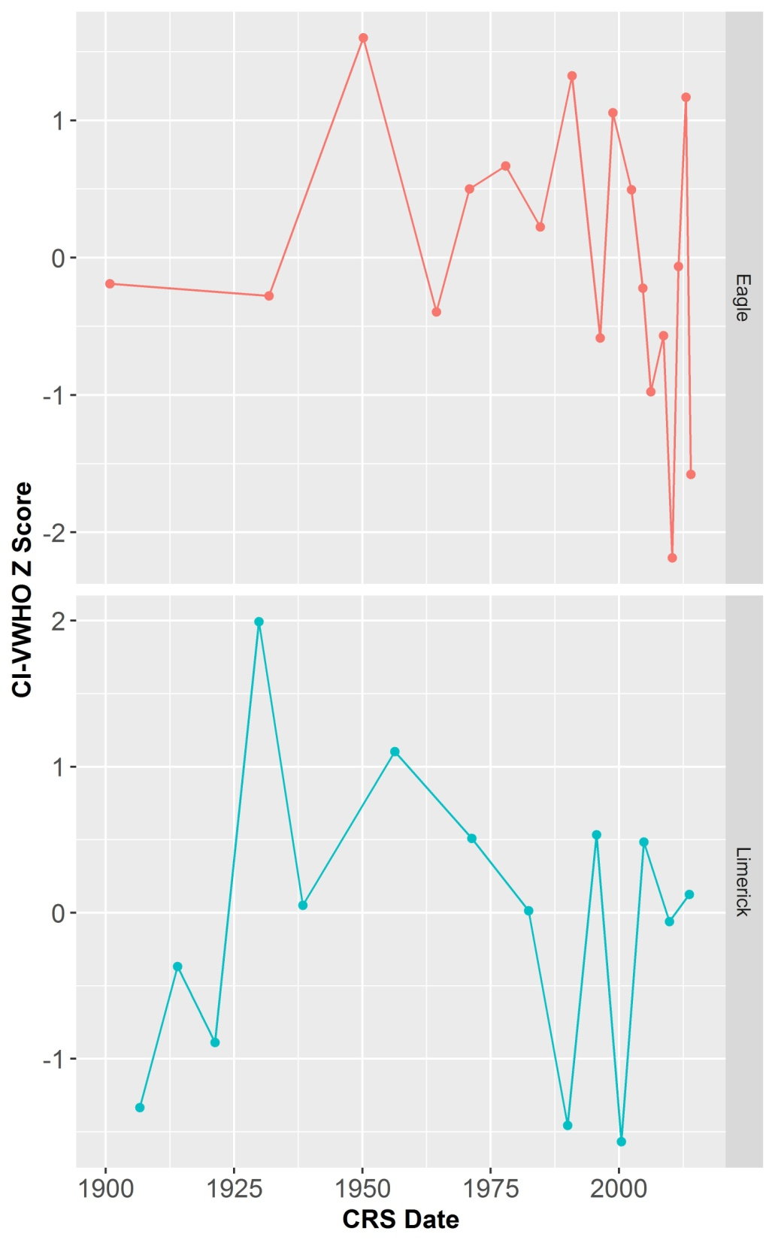
Chironomid-inferred VWHO Data
CI-VWHO trends were lake specific
Only Harp Lake and Peninsula Lake had significant directional trends in CI-VWHO since ~1900
Interestingly, a few of the study lakes exhibit a slight increase in CI-VWHO in the most recent sediments
The transition lakes undergo decreasing (but not significant) trends in CI-VWHO
Transition Lakes
*
*
Notes:
Eagle and Limerick highly variable CIVWHO, look like they have decreased (but not significant – limerick not monotonic)

Slide 11
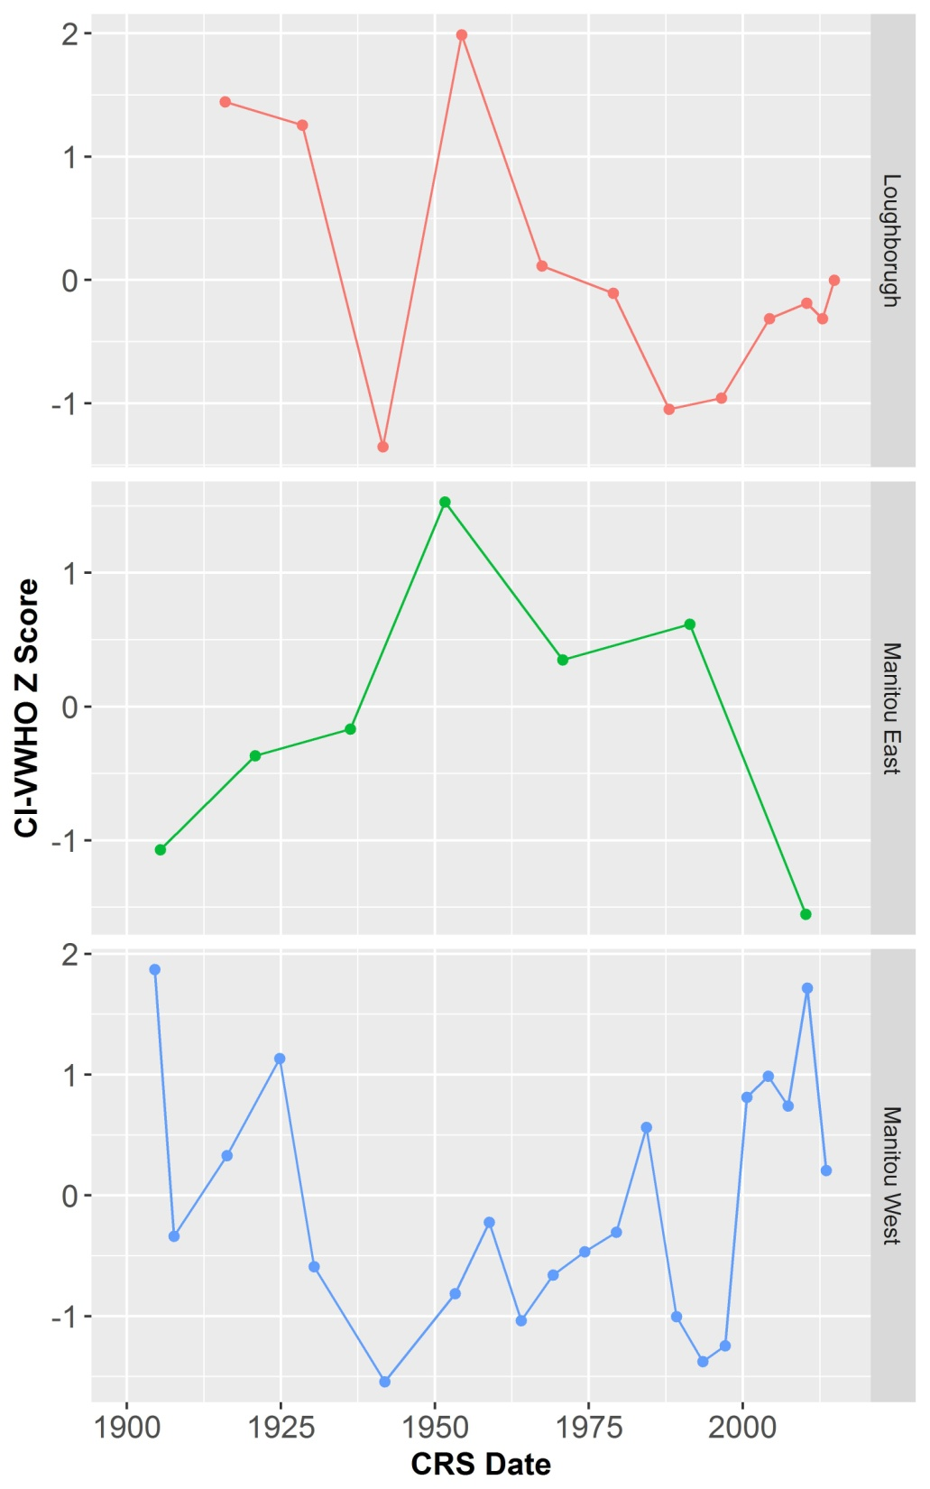
Chironomid-inferred VWHO Data
CI-VWHO trends were lake specific
Only Harp Lake and Peninsula Lake had significant directional trends in CI-VWHO since ~1900
Interestingly, a few of the study lakes exhibit a slight increase in CI-VWHO in the most recent sediments
The transition lakes undergo decreasing (but not significant) trends in CI-VWHO
We also observed opposing CI-VWHO trends in different basins within the same lake (Lake Manitou)
Off-Shield Lakes
*
*
*
*
*

Slide 12
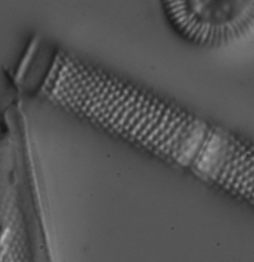
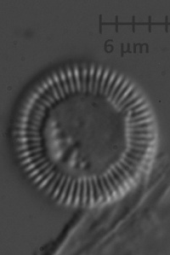
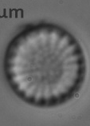
Summary of Diatom Assemblage Trends
Shield Lakes
Transition Lakes
Off-Shield Lakes
Gradual/subtle changes in diatom assemblages consistent with warming
Pronounced shifts in diatom assemblages consistent with warming
Decrease in mesotrophic taxa
Diatom assemblage shift consistent with warming in Lake Manitou
Increase in mesotrophic taxa in off-Shield lakes
Warming + Nutrient Recovery
Warming +
Nutrient Loading
Gradual Warming
Notes:
Shield Lakes: changes generally gradual and subtle (in Red Chalk and recently in Pen). Most prominent change in Pen diatom assemblages reflect earlier water quality degradation and very recent (and subtle) increase in small cyclotelloid taxa and decrease in Aulacoseira
Transition: decrease in mesotrophic taxa in Eagle (slight decrease in Limerick – less apparent)
Off-Shield: increase in mesotrophic taxa in both off-shield lakes. Loughborough increase in lightly silicified S. minutulus – maybe a response to warming (?) in addition to increasing nutrients

Slide 13
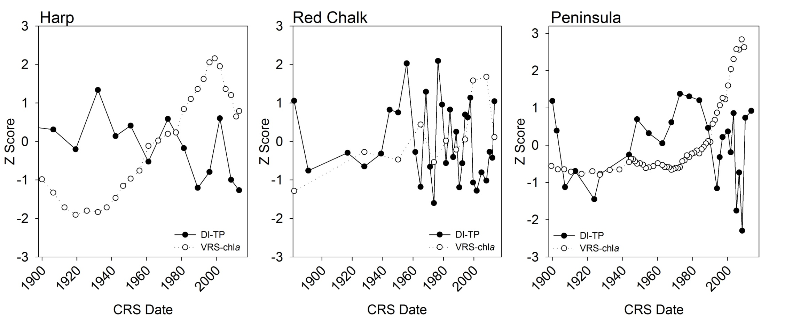
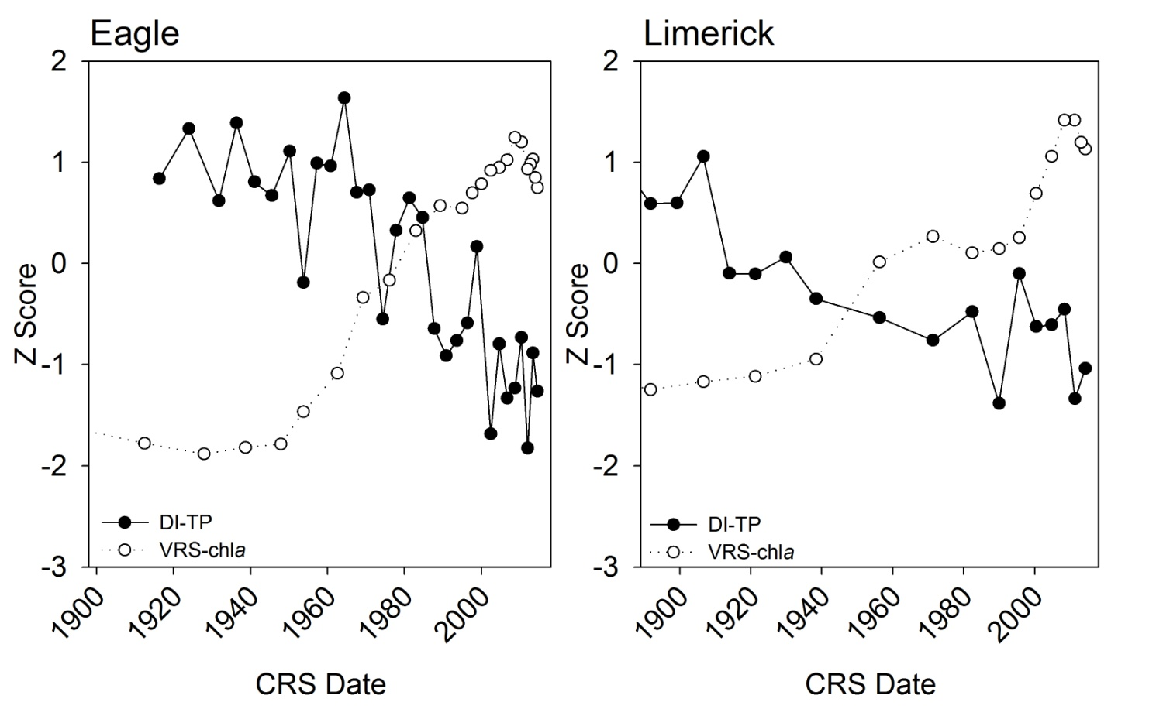
VRS-chlorophyll-a and diatom-inferred TP (DI-TP)
Shield Lakes
Transition Lakes
Increasing sedimentary-inferred chlorophyll-a observed alongside stable or decreasing DI-TP
Notes:
No significant trend in TP in Shield lakes, but increasing significant trend for chla in Shield lakes
Significant decreasing trend in TP in Eagle and Limerick, and increasing chla trend

Slide 14
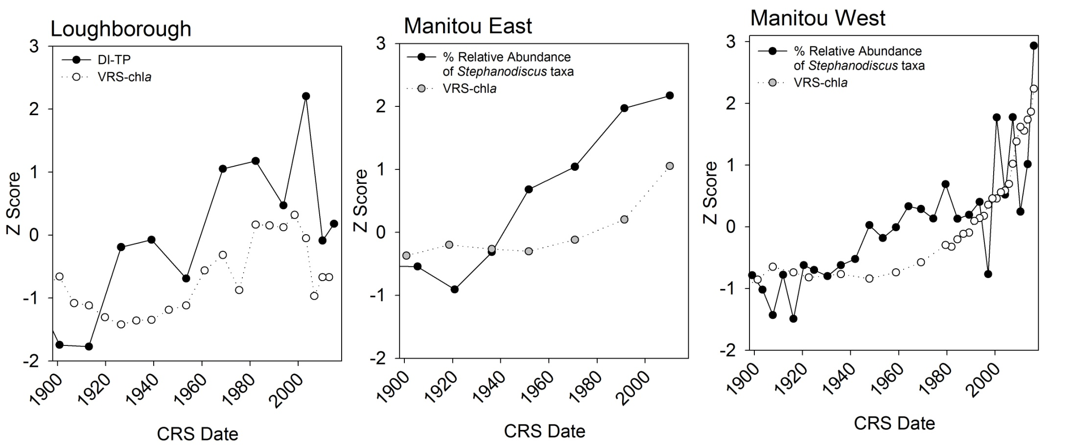
VRS-chlorophyll-a and diatom-inferred TP (DI-TP)
Off- Shield Lakes
In lakes located off-Shield, both sedimentary chlorophyll-a and DI-TP (or the % relative abundance of mesotrophic Stephanodiscus taxa) have increased
VRS-chlorophyll-a has increased to above early-1900s concentrations in all lakes

Slide 15
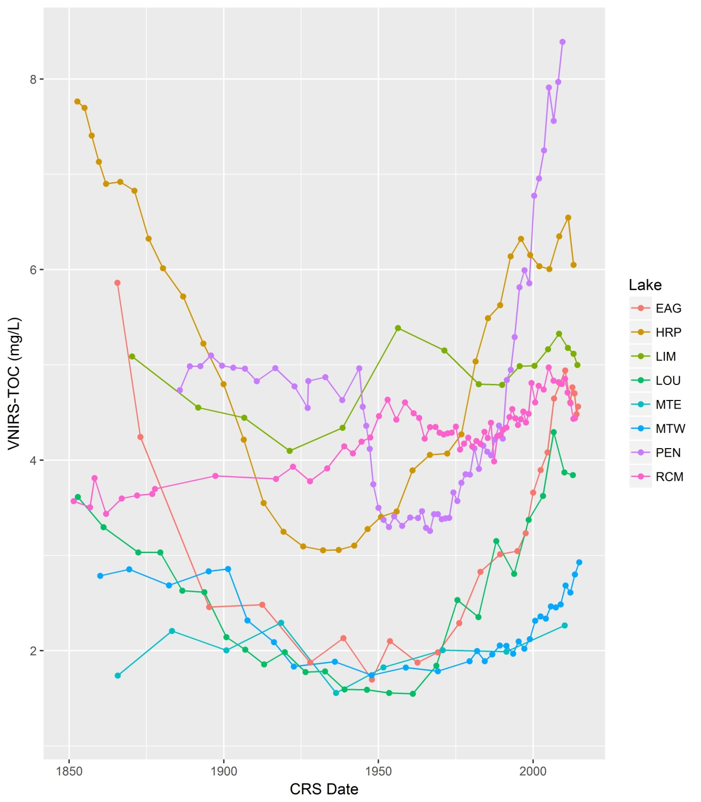
Total Organic Carbon (TOC)
Spectrally-inferred TOC decreased during the late-1800s and has increased across all lakes following recovery from acidification
The slight increases in CI-VWHO observed in some lakes may be associated with increasing TOC (e.g. Peninsula and Harp lakes - which undergo the highest increases in TOC)

Slide 16
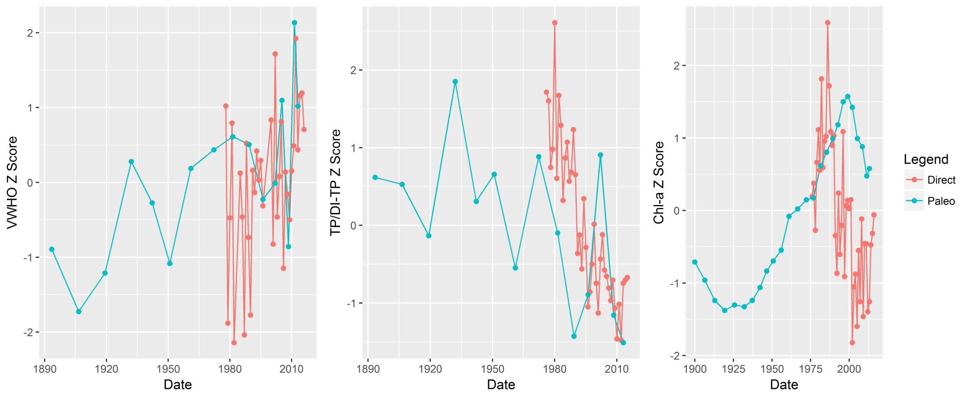
How do paleo-inferred trends compare with direct monitoring data ?
Harp Lake
Trends are generally consistent between direct monitoring data and paleo-reconstructions (potentially a slight lag in the paleo chla data)

Slide 17
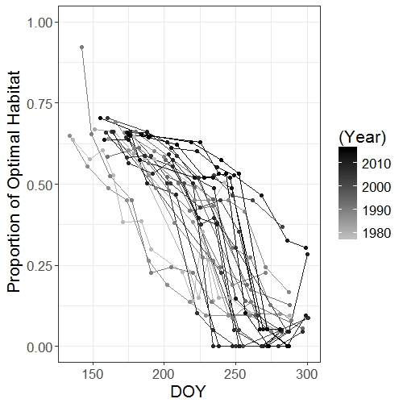
What does increasing VWHO mean for Lake Trout habitat?
Year
Day of Year
Harp Lake

Slide 18
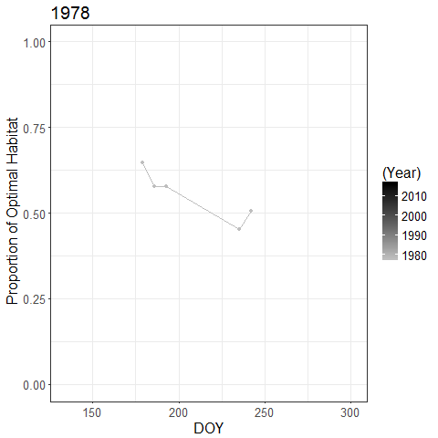
What does increasing VWHO mean for Lake Trout habitat?
Harp Lake
Year
Year
High proportions of optimal Lake Trout habitat are present for longer into the year before decreasing to seasonal minimum
Day of Year
Harp Lake

Slide 19
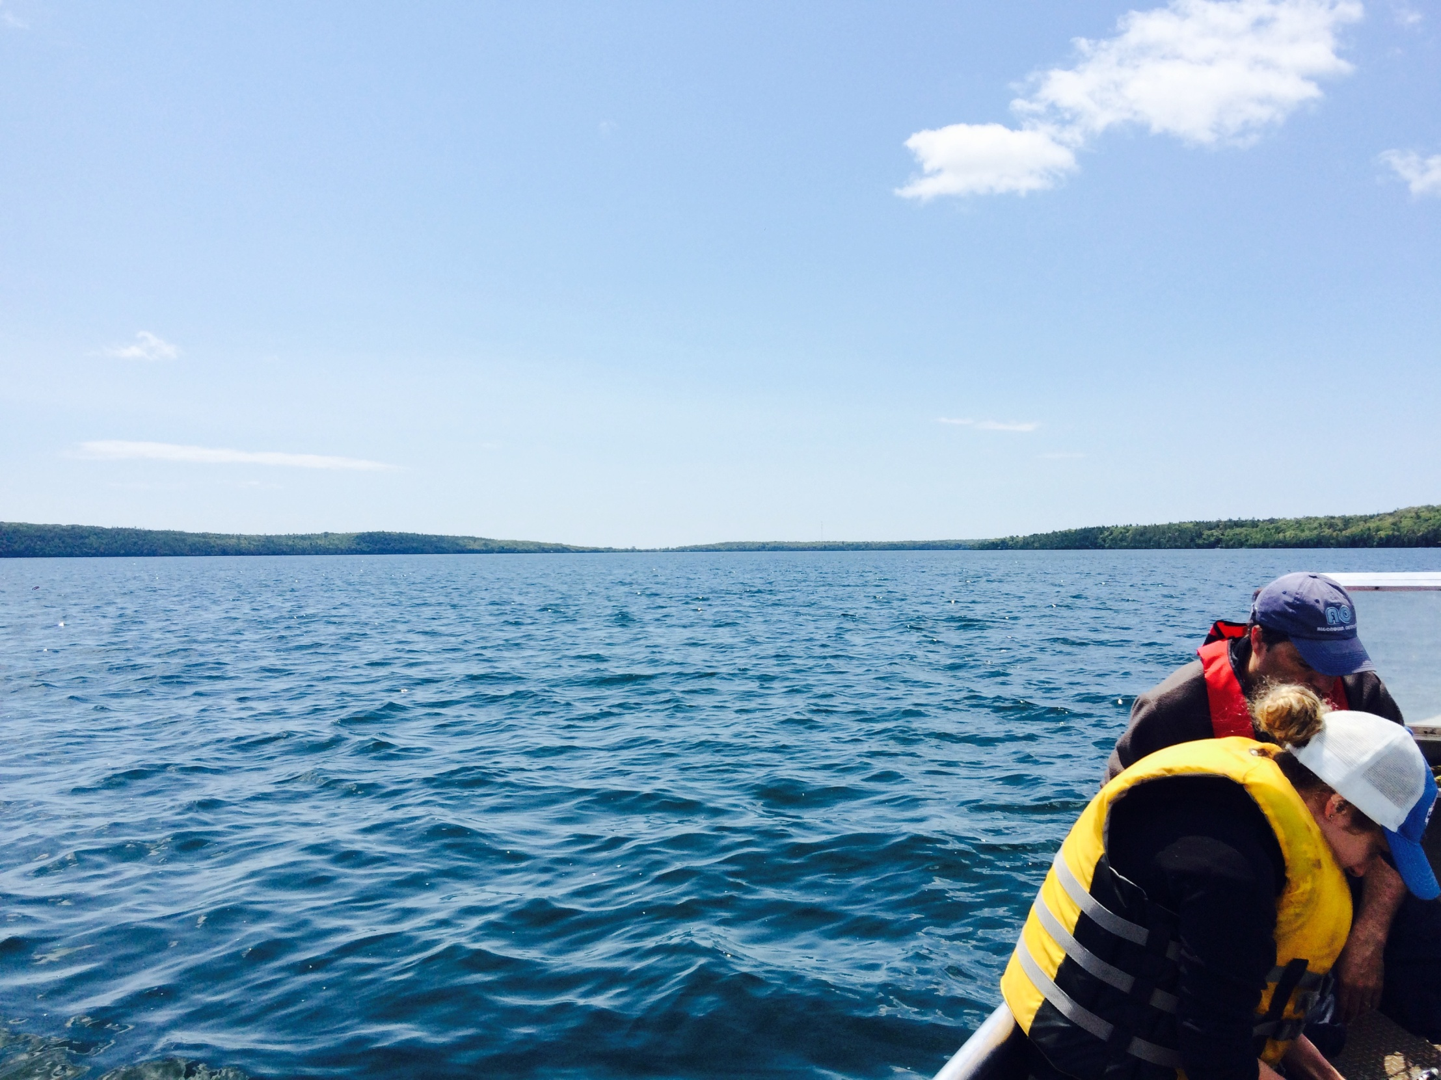
Conclusions
VWHO trends appear to be lake-specific and subtle
Trends in environmental variables that can influence oxygen were generally coherent across lakes and/or regions. For instance:
    Most lakes record diatom assemblage shifts consistent with warming-induced changes in lake thermal properties (i.e. stability and mixing)
    Nutrients have increased in off-Shield lakes
    Sedimentary-inferred chlorophyll-a and TOC have increased across all lakes
This may suggest that changes in environmental variables that can influence VWHO are not yet of a great enough magnitude to influence oxygen dynamics in many of these systems
These data also suggest that off-Shield lakes may be more sensitive to water quality degradation from nutrient loading

Slide 20



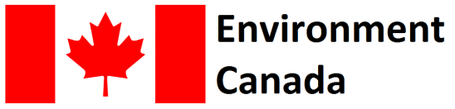
Thank you for listening!
Summary:
VWHO trends appear to be lake-specific and subtle
Trends in environmental variables that can influence oxygen were generally coherent across lakes and/or regions
This may suggest that changes in environmental variables that can influence VWHO are not yet of a great enough magnitude to influence oxygen dynamics in many of these systems
These data also suggest that off-Shield lakes may be more sensitive to water quality degradation from nutrient loading
Acknowledgments: Liz Favot, Branaavan Sivarajah, Ron Ingram, Hillary Austin-Quinn, Jenny Moe, the Blue Jay Creek Hatchery staff, and PEARL

Slide 21
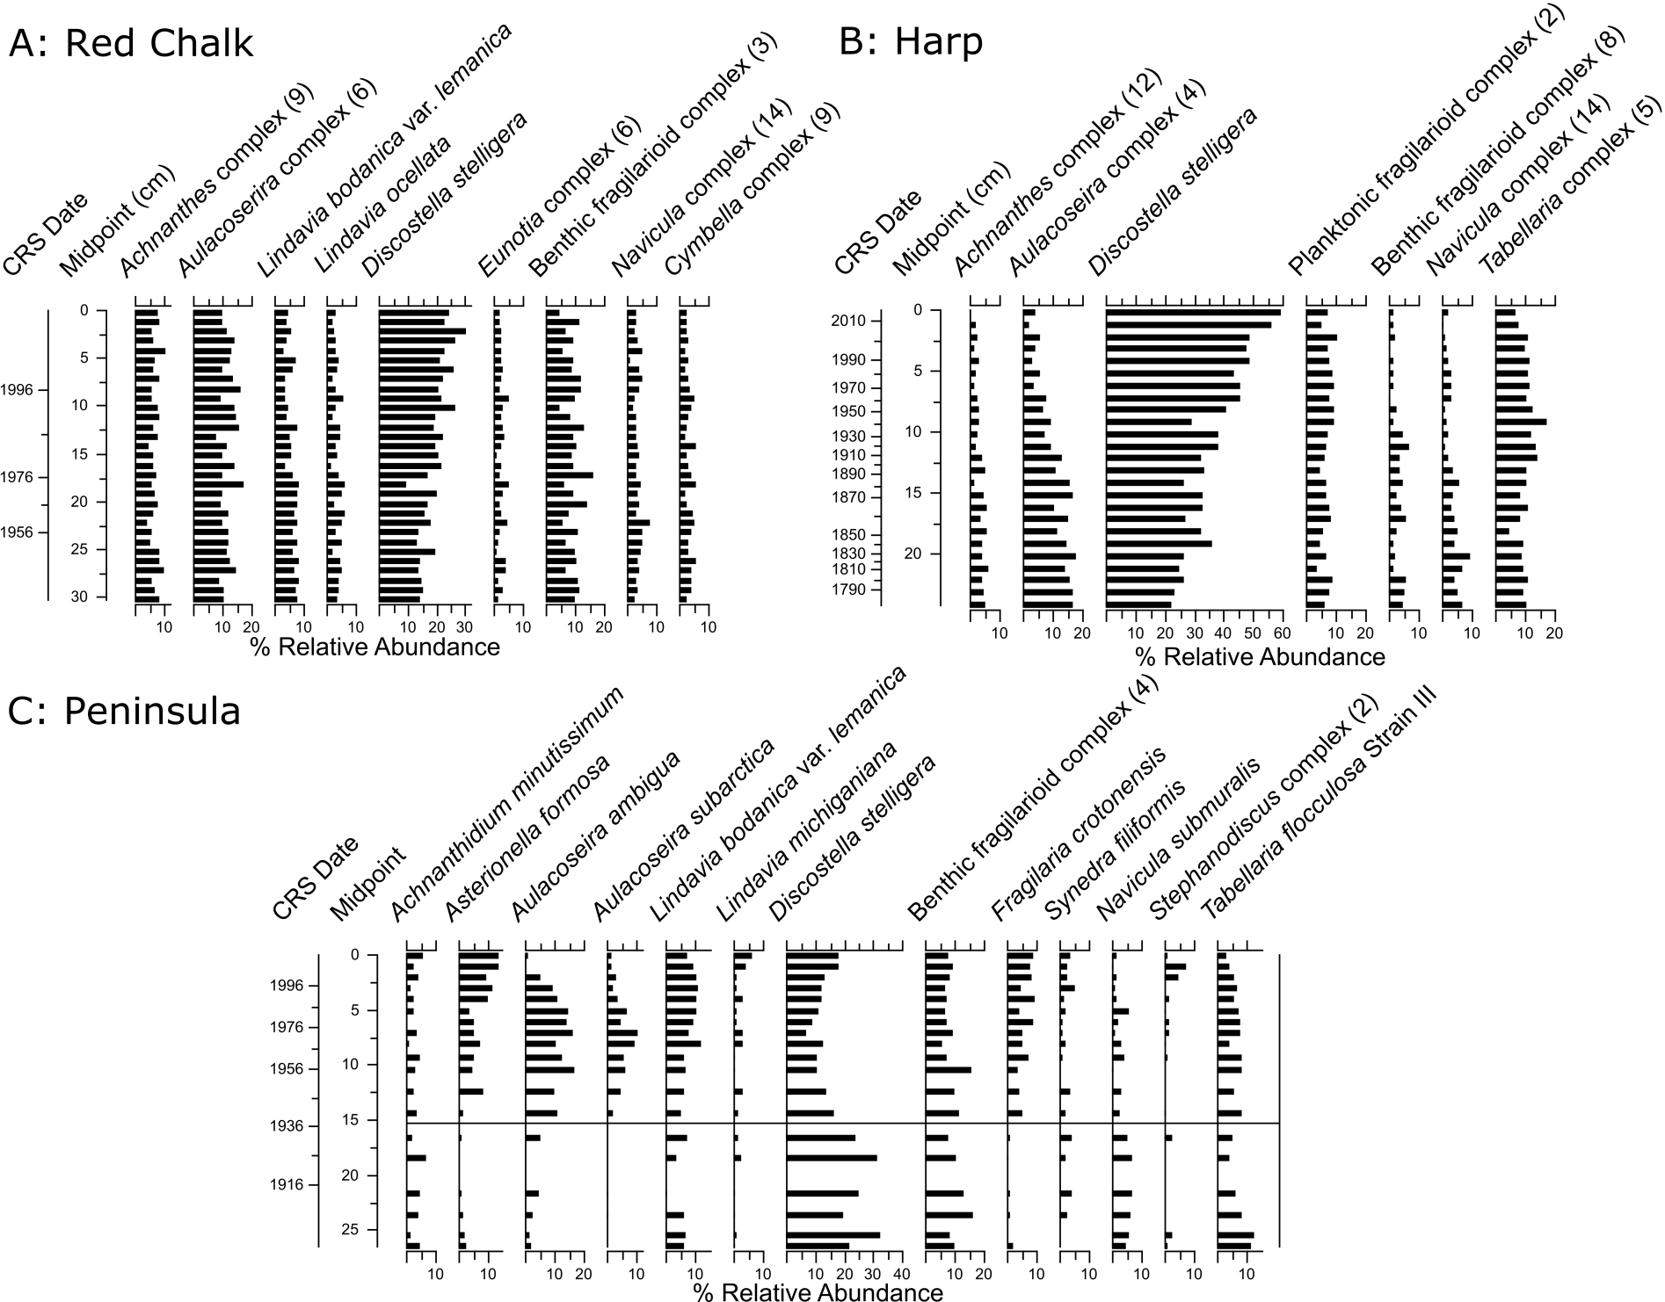
Shield Lakes
Subtle changes
Gradual increase in D. stelligera
Gradual increase in D. stelligera and decrease in Aulacoseira taxa
Historical degradation in water quality from initial settlement and development (Clerk et al. 2000)
Recent (and subtle) increase in D. stelligera and decrease in Aulacoseira taxa

Slide 22
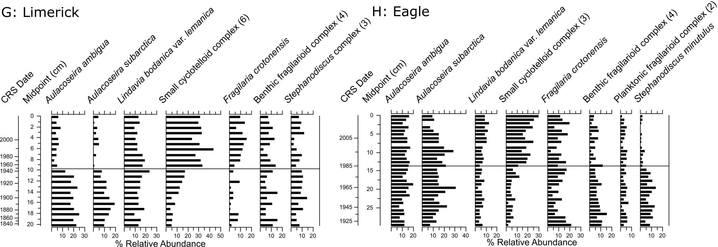
Boundary/Transition Lakes
Increase in small cyclotelloid taxa and decrease in Aulacoseira taxa that occur at different times in the paleo record
Decrease in Stephanodiscus taxa in Eagle Lake

Slide 23
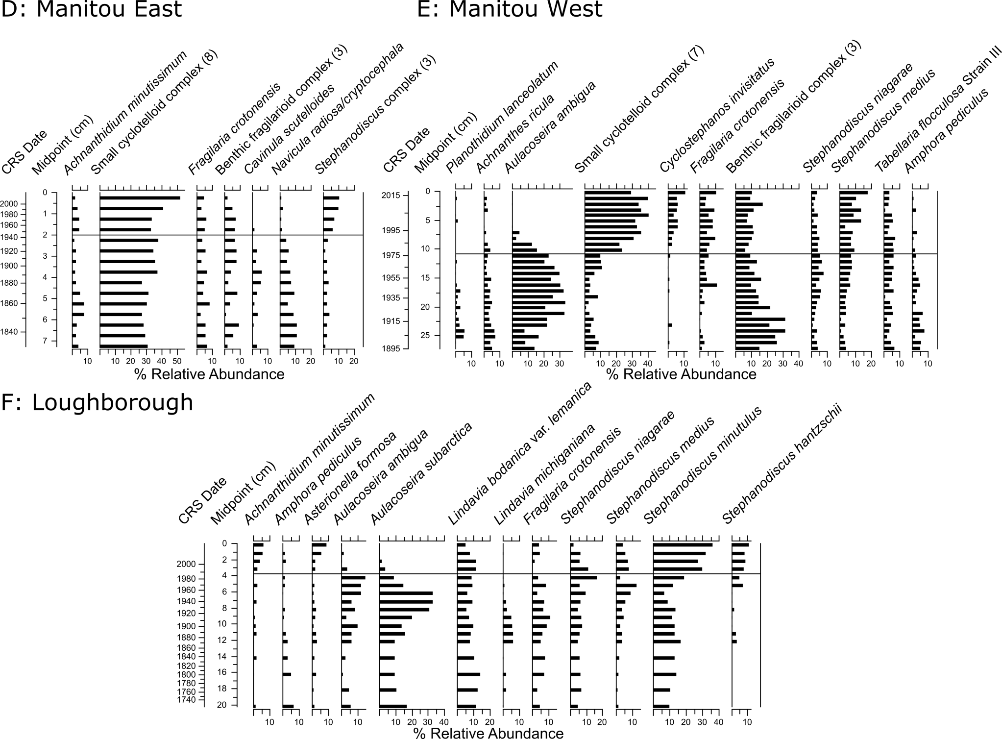
Off-Shield Lakes
Increase in Stephanodiscus taxa and small cyclotelloid taxa
Increase in Stephanodiscus taxa
Increase in small cyclotelloid taxa and decrease in A. ambigua and benthic fragilarioids
Diatom assemblages dominated by mesotrophic taxa that increase after ~1980
Decrease in A. subarctica and increase in small, lightly silicified S. minutulus (may be associated with warming)

