Slide 1
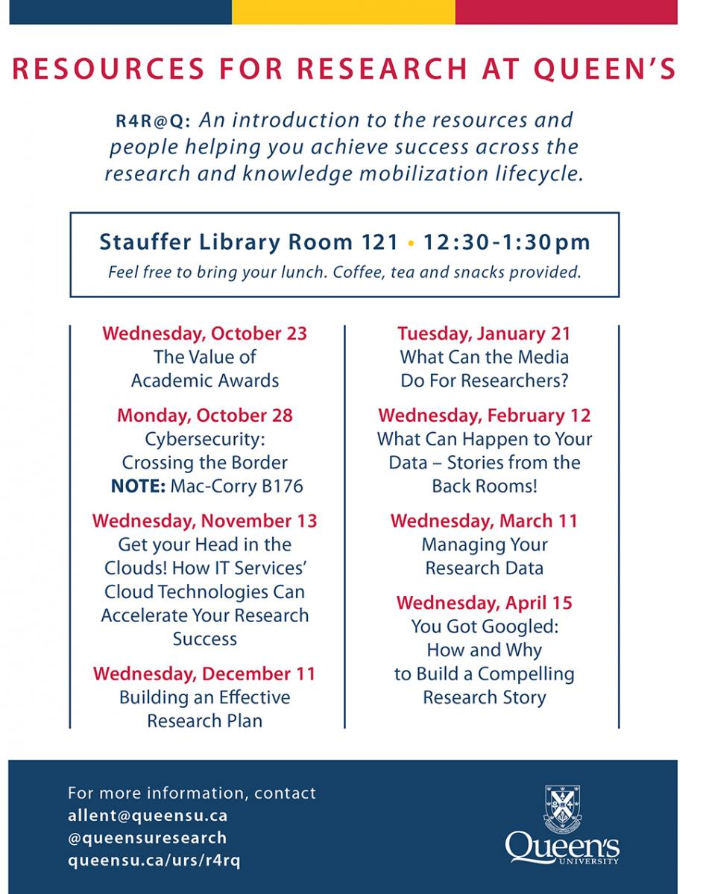
Notes:
The Resources for Research at Queen’s (R4R@Q) series is a monthly, brown bag lunchtime series meant to connect Queen’s researchers with the resources and people that can help chart a course for research success.
Now in its second season, the series is led by University Research Services in collaboration with the Library, Office of Partnerships and Innovation, ITS, Office of the Vice-Principal (Research), the Centre for Advanced Computing, and University Relations. The partnership demonstrates the variety of units and departments across campus that have a critical role to play in the research trajectory – from idea inception to commercialization.
"To begin, let us acknowledge that Queen’s is situated on traditional Anishinaabe and Haudenosaunee territory. We are grateful to be able to be live, learn and play on these lands.“

Slide 2
R4R@Q: Managing your Research Data
Courtney Matthews, Head, Open Scholarship Services
Will Roy, Open Scholarship Services Librarian
2020-03-11
Notes:
Welcome to the library

Slide 3
Agenda
Introduction to research data management
Activity #1 – Data Disasters
Data Management Planning
Activity #2 – Discovering Data
Data Deposit / What is a Data Repository
Resources
Notes:
The session will introduce and engage you with Research Data Management (RDM) concepts, newly emerging research responsibilities, and the supports and resources that are available to facilitate best practice approaches to managing data.
Participants will learn how to:
Comply with the DRAFT Tri-Agency Research Data Management Policy
Create a data management plan
Deposit and share data in a repository after project completion
We have two short activities planned which require you to form small groups with people at your table or close by. Each of you should have a double sided activity sheet with instructions.

Slide 4
What are research data?
Experimental data, observational data, operational data, third party data, public sector data, monitoring data, processed data, or repurposed data
All other digital and non-digital content have the potential to become research data
Primary sources supporting research, scholarship or artistic endeavours
Can be used as evidence to validate findings and results
Notes:
I’m going to begin by outlining what me might mean when we say ‘research data’.
When thinking about this topic, we have to acknowledge that research data comes in a variety of forms, and depending on the context in which it is gathered, it could look quite different.
And in addition, we could be talking about data gathered in the physical world, that is later converted to a digital representation.
It’s helpful to underline two key concepts in the context of talking about research data management.
Materials that act as a primary source, which supports your research.
And data that is used as evidence to validate your research claims.
With this understanding of data, we can recognize that it is important it is as a researcher who handles data to be practicing care and due diligence.

Slide 5
A Few Scenarios…
“PhD student offering $5,000 reward after car thief steals all his research”
CTV News, 2017
“Years of genomics research is riddled with errors thanks to a bunch of botched Excel spreadsheets”
Quartz, 2017
Notes:
But despite that, we can point to specific examples in research environments, where this is not occurring.
Just imagine, for instance, if you as a supervisor had your PhD student lose all of their collected research and data in a car theft, as is reported here by CTV news.
This is something that could have been avoided with some better planning, and considerations into how to backup and safely store this data.
And in another, which was found to be proliferating across a whole collection of reported research in the field of genomics, a
*** Could be that due to a lack of oversight or quality control,
These things do happen.

Slide 6
RDM Big Picture: Information Loss
"I estimate that 80% of all research data is collecting dust in drawers or dying on a hard drive. With this, along dies the information it contains" (Translation)
Martijnn Kleppe, Historian, Erasmus University.
Kleppe, Martjin (2013). Sharing Data: Good for Science, Good for You. (video) Published by Data Archiving and Network Services. Retrieved from https://www.youtube.com/watch?v=HJbo-OAaJ1I
Notes:
Beyond these kinds of specific examples we can point to where management of data is not occurring.
A cultural wide phenomenon

Slide 7
RDM Big Picture: Protection of Assets
“Research data are a national asset, but not treated as such. Research data were developed through significant investments by Canadian governments over many decades and in many fields.”
Leadership Council for Digital Infrastructure (2014).
Notes:
In light of some of this, in recent years questions have arisen as to whether data should be treated differently.
Once you recognize the fact that data are considered an asset, you have a greater impetus to protect that data from risk.

Slide 8
RDM Big Picture: Risk Mitigation
• Natural disasters …
• Facilities/infrastructure failures …
• Storage failure …
• Server hardware or software failure …
• Application software failure …
• Human errors …
• Malicious attack …
• Format obsolescence …
• Loss of competencies …
• Loss of funding …
Source: https://www.dataone.org/education-modules
Notes:
There is a myriad of ways that data can be compromised, and RDM gives researchers tools to plan and strategize about how to mitigate these risks (Read a few examples)

Slide 9
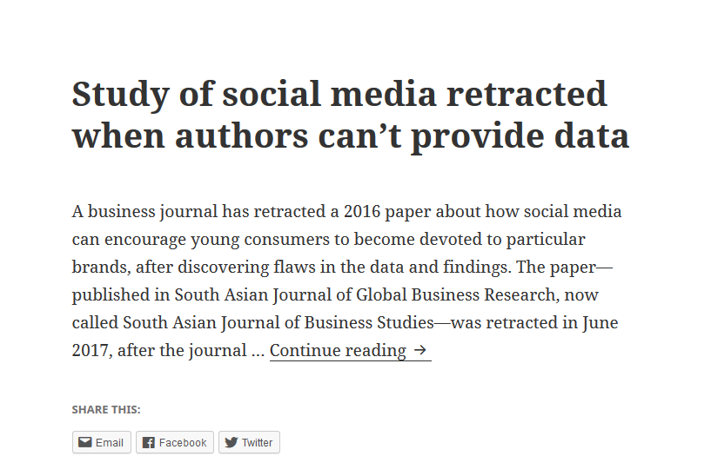
RDM Big Picture: Transparency/Accountability
Source: www.retractionwatch.com
Notes:
There has been a growing reproducibility crisis in science, and one issue at the heart of this crisis is that data is not well documented, can sometimes not be verified, or in the worst case scenario cannot be found.
Retractions, or other accusations of research misconduct, can be embarrassing for the reputations of those researchers and the institutions they work for.
RDM provides a pathway for researchers to work more efficiently, to keep better documentation of their processes, and to hold themselves to a higher degree of accountability, thus increasing the transparency of their research.

Slide 10
What is research data management (RDM)?
Processes applied throughout the lifecycle of a research project to guide the collection, documentation, storage, sharing, and preservation of research data.
Notes:
It’s worthwhile to have a formalized, working definition.
RDM refers to the processes applied throughout the lifecycle of a research project to guide the collection, documentation, storage, sharing, and preservation of research data.
(point out the different activities in blue bubbles)
Ensuring data is complete, understandable, and secure throughout all activities helps maximize the potential for sharing, archiving and reuse at the end of a project.
And now Courtney is going to talk further about some of the benefits of RDM, and is going to talk about how we’re seeing this concept be unrolled in Canada

Slide 11
Why should I manage my research data?
Increase the impact of your research
Work efficiently and save future effort
Ensure long-term preservation of data
Comply with ethics and privacy policies
Meet grant requirements and write more competitive grant application
Notes:
By proactively managing your research data:
Increase the impact of your research by making it more visible and more citable
Work efficiently by documenting your data throughout its life cycle will saves time and ensure that you and others will be able to understand and use your data in the future. It helps you to gain an awareness of the costs, benefits and challenges associated with sharing your research data.
Long term preservation: you want to ensure that your data is intact and accessible for others to examine, verify, or reproduce your study
Comply with ethics and privacy policies: RDM helps you outline and document steps that keep you in line with legal and ethical obligations– whether that pertains to consent agreements, ethical treatment of human subjects, or federal and provincial legislation on privacy
To meet grant requirements by showing funders that you are committed to maximizing the value of your research data. This can help you to create a more competitive and attractive application package.

Slide 12
DRAFT Tri-Agency Research Data Management Policy
Released for public consultation in June, 2018
“…research data collected with the use of public funds should be responsibly managed and, where appropriate, available for reuse by others”
Requirements and recommendations:
Each institution must develop an institutional strategy
Researchers are encouraged to write Data Management Plans
Researchers are required to make a Data Deposit
Notes:
Speaking of grant and funder requirements the Tri-agency released a draft RDM policy for public consultation in 2018.
It is based on the principle that research data collected with the use of public funds should be responsibly managed and, where appropriate, available for reuse by others.”
It applies to institutions and to grant recipients administering tri-agency funds by setting out these requirements and recommendations.
Principle and rationale
Overall, the agencies found that there is broad support for the underlying principle of the policy: that research data collected with the use of public funds should be responsibly managed and, where appropriate, available for reuse by others.
https://www.science.gc.ca/eic/site/063.nsf/eng/h_97905.html
Draft Tri-A policy
2. Policy Objective
The objective of this policy is to support Canadian research excellence by promoting sound data management and data stewardship practices.
https://www.science.gc.ca/eic/site/063.nsf/eng/h_97610.html

Slide 13
Preparation for the policy
Summer 2018: Queen’s response coordinated by the Library, ITServices and the Office of the Vice-Principal (Research) and submitted to the Tri-Agency
December 2018: Public consultation summary released
Spring 2020: Anticipated release of finalized policy
Notes:
Queen’s has been engaged with draft policy since it’s release.
During the Summer of 2018 a response to the draft policy was coordinated and submitted by the library, ITS and the OVPR with input sought from the research community. The response included a summary of actions to be taken and services that Queen’s offers to meet the policy’s recommendations and requirements.
You can read the public consultation summary on the Tri-Agency’s website.
We’re anticipating that the policy will be released this Spring 2020.

Slide 14
What can we anticipate?
Anticipated requirements and recommendations:
Each institution must develop an institutional strategy
Researchers are encouraged to write Data Management Plans
Researchers are required to make a Data Deposit
Policy to be phased in over several years: Institutional strategy, Data Management Plans, Data Deposit
We won’t know the exact details of the policy until it’s released
Notes:
According to the public consultation summary we can anticipate that many elements of the draft recommendations and requirements will be included in the finalized policy.
We can also anticipate that the elements of the policy will be phased in over several years.
We won’t know the exact details of the policy until it’s released
The activities and services we’ll talk about today will help you to navigate and meet the anticipated DMP recommendation and Data Deposit requirement.
__________________________________________________________________________
IMPLEMENTATION TIMELINE: According to the Public Consultation there was broad agreement that the policy should be phased in over several years.
INSTITUTIONAL STRATEGY: Section 3.1 of the draft policy requires each institution administering tri-agency funds to create an institutional RDM strategy. Many submissions, especially from research institutions, commented on this requirement.
DATA MANAGEMENT PLANS: Section 3.2 of the draft policy encourages researchers to create DMPs. It states that, for specific funding opportunities, the agencies may require DMPs to be submitted to the appropriate agency at time of application. In these cases, the DMPs may be considered in the adjudication process.
DATA DEPOSIT: Section 3.3 of the draft policy requires grant recipients to deposit data and other research outputs into a recognized digital repository. Specifically, it requires deposit of digital research data, metadata and code that directly supported the research conclusions in journal articles, pre-prints and other research outputs that arise from agency-supported research.

Slide 15
Activity #1 – Data Disasters
Notes:
To help get a sense of the how to meet the policy’s recommendations and requirements we’ll turn to our first activity.

Slide 16
Activity #1 – Data Disasters
Time: 10 minutes
Read the Data Disaster scenario with your group
With your group discuss what you would do if this happened and how it could have been avoided
One person per group will provide feedback (time permitting)
Notes:
1 minute to explain the scenario
5-6 minutes to read and discuss
3 minutes for feedback
In groups of X
This scenario presents you with an unexpected event that could have a devastating impact on your research.
You can avoid or at least mitigate the impact of a disaster by doing some planning prior to beginning your research and collecting your data.

Slide 17
Data Management Plan
Notes:
The activity demonstrated how having a plan can help to avoid or mitigate a data disaster.

Slide 18
Support for RDM
“Fostering a community of practice for research data”
Training Resources
Network of expertise
Tools and Infrastructure for RDM
https://portagenetwork.ca/training-resources/
Notes:
In Canada we are fortunate to have the Portage network to help us plan. Portage provides a community of practice, and leverages a network of expertise that consists of professionals and stakeholders working in RDM across the country.
It develops best practices and creates free resources, training and tools for researchers working with data including brief guides and primer documents to get you started.
They offer quick introductions to RDM topics that provide easy, transferable tips for managing your data.

Slide 19
Write a data management plan
Use the Portage DMP Assistant tool to develop your own data management plan. It is freely available to all researchers in Canada and provides step-by-step guidance through a series of questions based on a general template for research data stewardship.
Notes:
They also provides the DMP Assistant, a free tool for writing data management plans.
You login, select a template and begin answering guided questions about your data.
At the end you get a living document that you can draft, iterate, share and revisit at any time.
And sections of your DMP can be used in your ethics and grant applications.

Slide 20
DMP Assistant
Data Collection
Documentation & Metadata
Storage & Backup
Preservation
Data Sharing & Reuse
Responsibilities and Resources
Ethics & Legal Compliance
The DMP Assistant guides you through a checklist of questions.
Notes:
Those questions are broken into 7 categories, 21 questions in total.
It’s important to note that not all questions will apply to all research projects.
You can answer the questions relevant to your work and revisit the tool throughout your research to review, update or complete your responses.
______________________________________________________________________
Some questions from each section include:
Data collection: What file formats will your data be collected in and will these formats allow for data re-use, sharing and long-term access to the data?
Documentation and Metadata: If you are using a metadata standard and/or tools to document and describe your data, please list here.
Storage and Backup: How and where will your data be stored and backed up during your research project?
Preservation: Where will you deposit your data for long-term preservation and access at the end of your research project?
Sharing and Reuse: Have you considered what type of end-user license to include with your data?
Responsibilities and Resources: Identify who will be responsible for managing this project's data during and after the project and the major data management tasks for which they will be responsible.
Ethical and Legal Compliance: If your research project includes sensitive data, how will you ensure that it is securely managed and accessible only to approved members of the project?

Slide 21
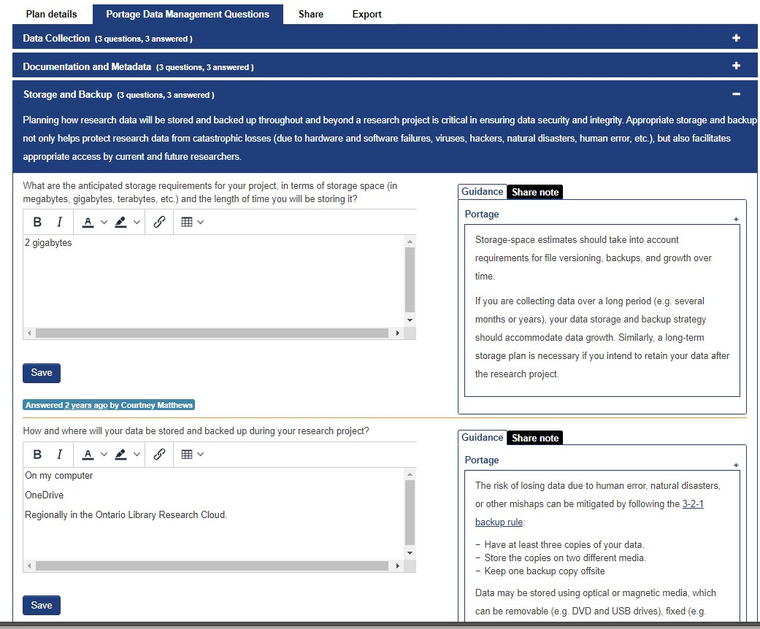
Data Management Planning Assistant
Notes:
This is the storage and backup section.
Each section provides guidance, examples and links to further information that are useful for filling out the form.
You can share the DMP with anyone who has an email address and assign them roles: co-owner, editor, read-only.

Slide 22
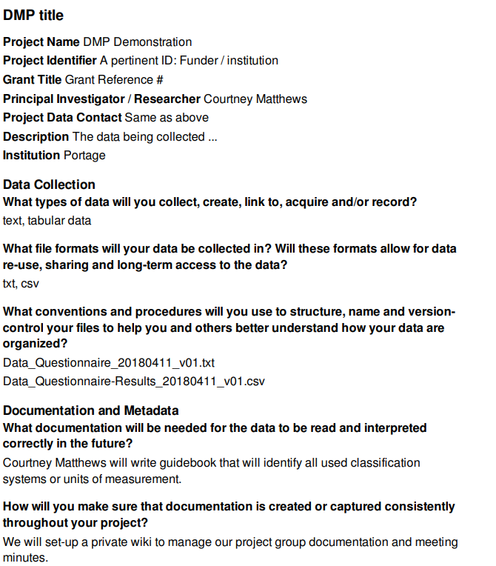
Completed DMP
Notes:
Completed DMP
When completed DMP can be exported (in multiple file formats), and used for collaboration and sharing with colleagues, review boards and other stakeholders (GREB, etc).

Slide 23
Active Data Management
Review data files
coding, formatting, anonymizing
converting to non-proprietary file formats
Organize your data
creating meaningful file structure; file naming
Document and describe your data
describing variables so others understand it
creating user guide, methodology, codebook, data dictionary
Notes:
Before Will talks about data depositing I’ll mention that there are a variety of activities that take place in the research lifecycle between planning and dissemination.
The create, process and analyze steps can be referred to as “Active data management”.
The library can work with you to
Review your data
Organize your data
And to document and describe your data
Our goal is to help you to make your data easy to understand so when you finish your project it can “speak for itself”

Slide 24
Depositing data
Notes:
We’ve been learning about the new policies around data management as advised by the Tri-Agency
In addition to having a data management plan.
The Tri-Agency also expects that researchers Deposit their Data into a recognized digital repository at the end of their project.

Slide 25
Sharing / Preserving your Data
“Research data resulting from agency funding should normally be preserved in a publicly accessible, secure and curated repository or other platform for discovery and reuse by others”
- Tri-Agency Statement of Principles on Digital Data Management (2016)
Notes:
The tri-agency recommends that data be preserved in a publicly, accessible, secure and curated repository.

Slide 26
Activity #2 – Discovering Data
Notes:
Activity number 2 is going to explore the ways in which discovery and reuse of data can be facilitated

Slide 27
Activity #2 – Discovering Data
Time: 10 minutes
Half the room has been provided with a Lego model representing a dataset. You are data curators.
The other half of the room has been given a short description documenting a ‘dataset’ that is of interest to your research. You are data users.
Your Tasks (without revealing your block or your description) :
Data curators: Create a brief description. One representative from each group will be asked to summarize your group’s description.
Data users: Review your description first, then listen to the data curator's description, and work with your group to identify the matching “dataset”.

Slide 28
Discovery of Research Data in Repositories
Repositories Provide Context, Descriptive Metadata and Persistent Discoverability of data.
Data is most useful when it is:
Findable
Accessible
Interoperable
Re-usable
Notes:
Our Activity - demonstrated the importance of having shared understandings for describing and contextualizing data, and how that can facilitate discovery and reuse.
Repositories are platforms that utilize technology, policy and governance to optimize the outcomes.
Many repositories aspire to meet the FAIR principles of data sharing, which stand for ….
Underlying the FAIR principles is the belief that through well documented, shared metadata vocabularies and open protocols for exchanging information across the web, you can have data that:
can be retrieved in a consistent and predicable manner
are well described and utilize shared metadata standards and vocabularies to aid in discovery
Is able to be discovered using relevant search tools and technologies that share a similar protocol.
That contains a clear and accessible data usage license – helping data producers to assert the desirable re-use conditions, and helping data users to understand how they are able to work with the data

Slide 29
A Data Repository Should:
Provide continued stewardship of data after a project is finished.
Assign persistent identifiers that support consistent and unambiguous data citation and linking.
Ensure controlled access to data, where appropriate.
Convert files to formats appropriate for both preservation and sharing.
https://portagenetwork.ca/planning-managing-data/frequently-asked-questions/

Slide 30
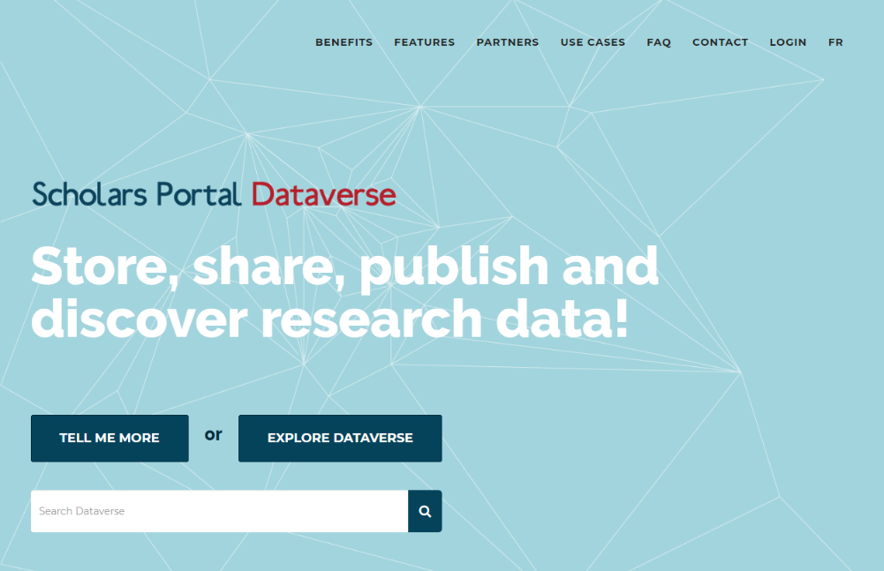
How do I share my research data?
Deposit your data in a disciplinary repository
Consult the Registry of Research Data Repositories https://www.re3data.org/
The library supported repository:
Scholar’s Portal Dataverse
https://dataverse.scholarsportal.info
Notes:
You might consider depositing your data in a discipline specific repository
Re3data.org is a registry of research data repositories, currently over 2000 listed there, very comprehensive resource.
The library will also assist in finding one that may meet your needs.
Scholars Portal is the service arm of the Ontario Council of University Libraries
Dataverse is a research data online platform that is free for all researchers associated with OCUL institutions to deposit
Open to anyone in the world to search and access data.
Non-OCUL researchers can be added as collaborators.
Some of the benefits include the fact that it is hosted in Canada on Canadian servers, and the bilingual functionality (toggle between two languages)
Dataverse is set up with institutional branding, which means that users can browse data from specific institutions and you can deposit into the Queen’s University dataverse, which helps to promote research conducted here and boost your research profile.

Slide 31
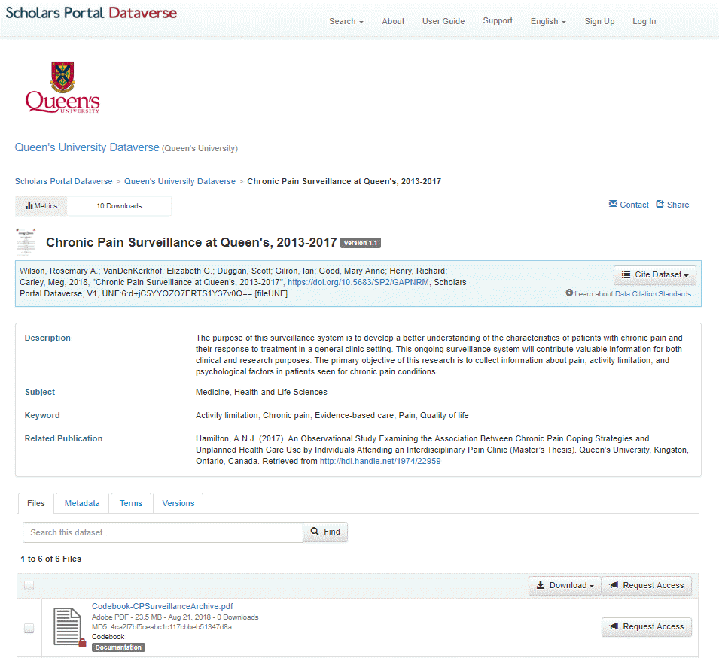
Dataverse Example
Notes:
Tour of a dataset
The blue box contains the data citation, including the permanent digital object identifier, and a tool to easily cite the dataset in certain formats.
Descriptive metadata is shown below, with description, subject, and keywords. Notice also a link to the publication that this data supports.
Tabs provide access to information about the files, metadata, terms of use, and versions.
This completed dataset has all the elements needed for you, or anyone else, to view, access and understand how to re-use the data contained within
You can ...
Review a basic description of what the data is, what it's about, and what publications it supports
cite the work
share and link to the record
clearly understand what rights you have to access and re-use this work
download the files that are openly available
contact the researcher to request access to particular files

Slide 32
When you use Dataverse:
Your data receives a DOI and a standard citation
You control access to your data
Increase discovery of your work
And much more: Scholar’s Portal Dataverse
Notes:
Point 1:
- Enable attribution & acknowledgement for your work
Point 2:
Choose to share with collaborators, the campus community, or the world
Assign custom terms of access, assign licenses
Point 3:
- Link to your publications, your ORCID
- Get indexed by Google Dataset search, SHARE notifications, and other online search indexes
Point 4:
There’s a range of other benefits to using this platform which you can read about on their website
Now Courtney’s going to outline some further resources that you can access on the topic of RDM

Slide 33
Resources

Slide 34
Researcher Training Program
The Research Training Program is an expanding set of self-serve training modules that will help you to successfully manage your digital research and scholarship effectively throughout the research lifecycle and at your point of need:
Getting Published
Open Publishing Support
ORCID and your Research Profile
Manage your Research Data
Notes:
The RTP was an output of the Digital scholarly record working group.
This group included the membership and support of faculty from CAC and civil engineering, also members from research services, and the school of grad studies , who each were consulted and provided input on these materials.
Avoiding Predatory Publishers and Conferences
Open Access Publishing
Distinguishing your research profile
Managing your research data

Slide 35
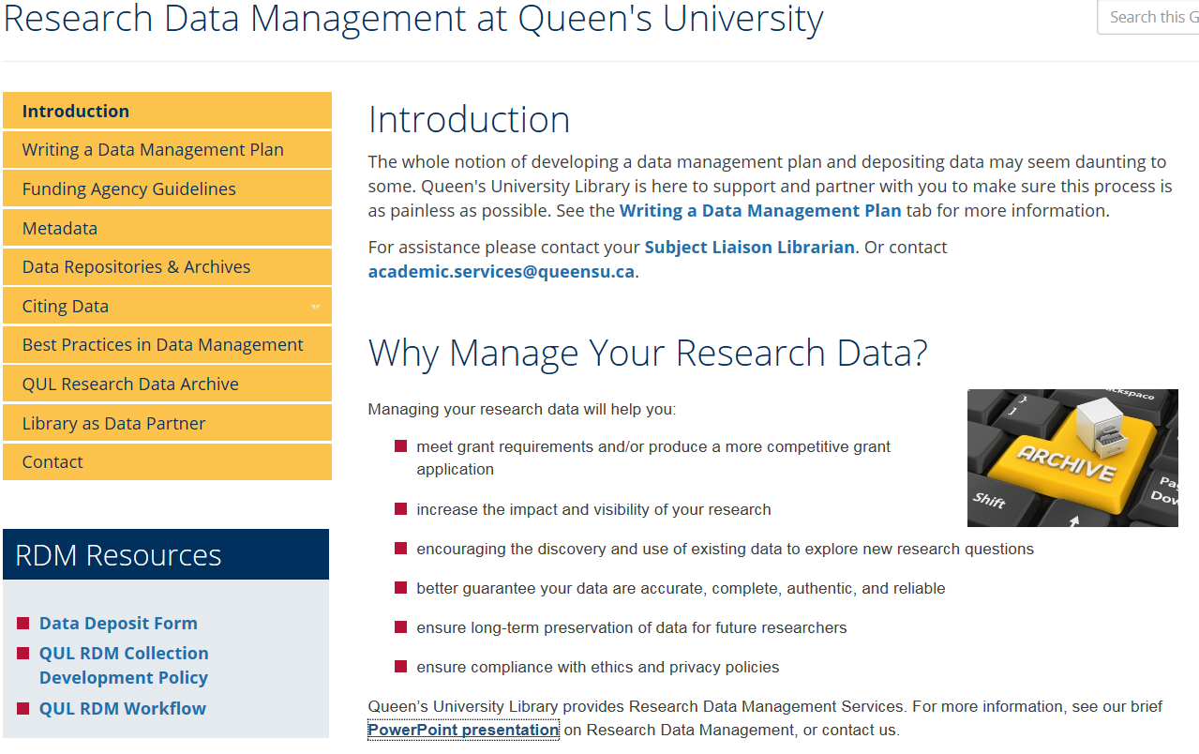
Resources
QUL Research Data Management Guide
Federated Research Data Repository
Portage Network
DMP Assistant
RDM Primer
‘Good Enough’ Research Data Management
Scholars Portal Dataverse
CIHR Research Data Management learning module
UBC Research Data Management DataGuide
Notes:
FRDR Sponsored by through a partnership between Canadian Association of Research Libraries, Portage Network, Compute Canada, FRDR is a national discovery layer for Canadian open research datasets, currently harvesting metadata from 39 repositories, including SP Dataverse. It is a source for Canadian research data available for reuse.

Slide 36
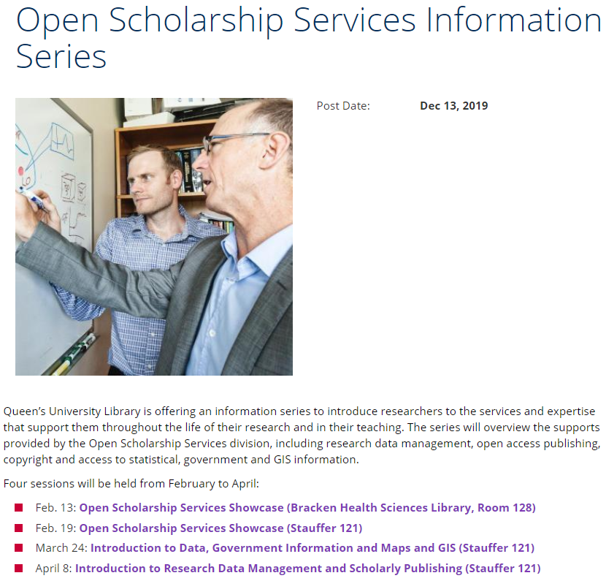
Welcome

Slide 37
Upcoming sessions
March 24: Introduction to Data, Government Information and Maps and GIS (Stauffer 121)
April 8: Introduction to Research Data Management and Scholarly Publishing (Stauffer 121)

Slide 38
Contact information
Contact us about RDM Courtney Matthews, Head, Open Scholarship Services Will Roy, Open Scholarship Services Librarian Alexandra Cooper, Data Services Coordinator Meghan Goodchild Acting Head, Discovery and Technology Services Research Data Management Systems Librarian, Scholars Portal / Queen’s
Contact your Subject Librarian for help with:
Research – Develop research strategies, manage data, publish research
Instruction – Support for teaching and learning, information literacy, course related sessions and programs
Resources – Access to information to support research and teaching

