Slide 1
The Green Office Certification Program Version 2.0
Sustainable Queen’s Presents

Slide 2
Why Green Office?
Queen’s has over 24,000 students and over 8,000 staff and faculty¹
We’re a mini city!
¹Queen's University. (2019, 10. 18). Quick Facts. Retrieved from Queen's University: https://www.queensu.ca/about/quickfacts

Slide 3
Categories
General Office Information
Energy Conservation
Waste Diversion and Reduction
Transportation and Travel
Purchasing/Procurement
Engagement and Awareness
² GFL Environmental. (2016, 10. 4/5/6). 2016 Waste Audit Report. Retrieved from Queen’s University:https://www.queensu.ca/sustainability/sites/webpublish.queensu.ca.suswww/files/files/WASTE%20AUDIT%20REPORT%202016%20(QUEENS%20UNIVERSITY).pdf

Slide 4
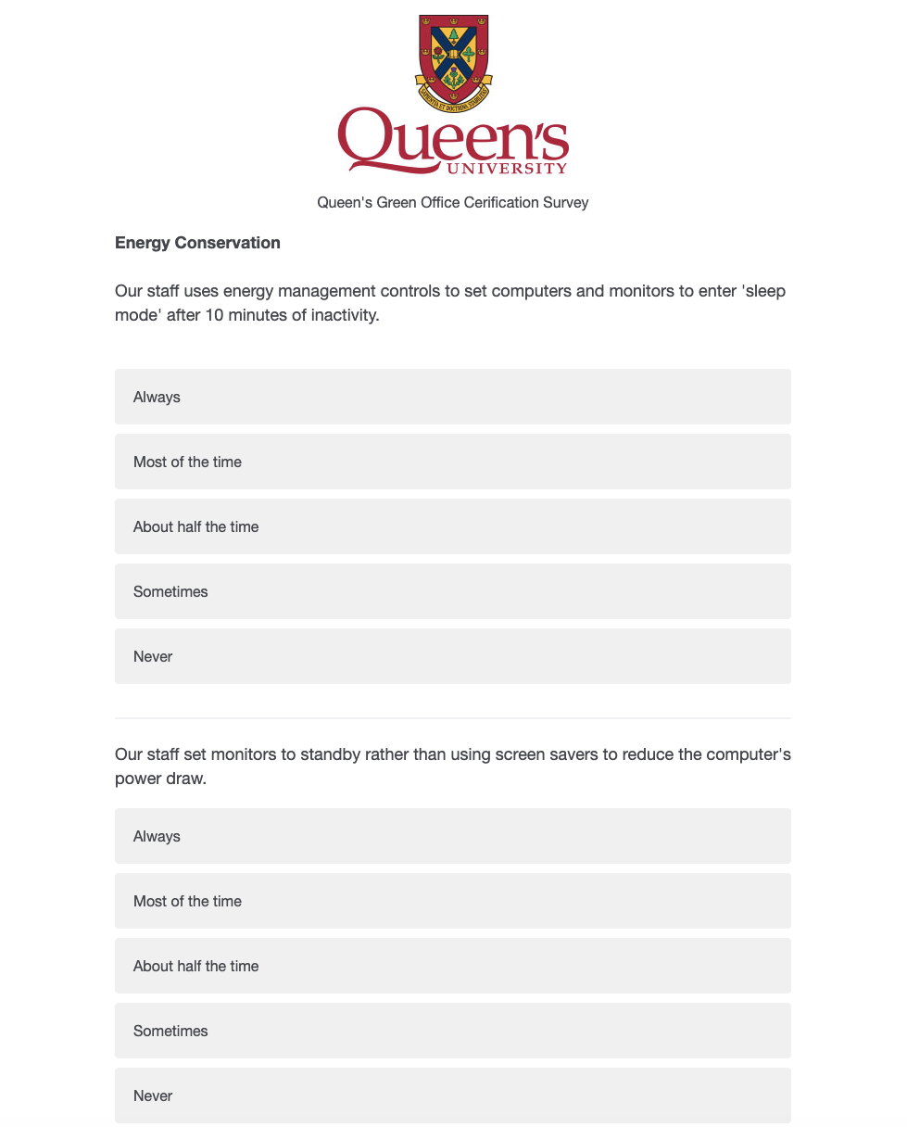
The Program
The updated program uses survey platform, Qualtrics to increase ease of use while reducing paper use
Survey takes less than minutes to complete, you can take as long as needed to gather data from your office
Notes:
The GOC certification provides a platform for offices to be more sustainable through xyz
Here is how y

Slide 5
How does it work?
Watch this presentation!
Fill out survey and submit
Get results from the Sustainability Office
Share with your team and discuss ways to improve score
Reassess in 6 months – 1 year
The scores of all participating
offices will be published on the
Sustainable Queen’s website

Slide 6
Who’s participating?
Financial Services – Bronze
University Secretariat - Silver
VP Finance - Gold
Career Services - Silver
School of Environmental Studies Platinum
Physical Plant Services – Silver
Internal Audit – Silver
Hospitality Services – Gold

Slide 7
Get started!
sustain@queensu.ca

